Slide 1
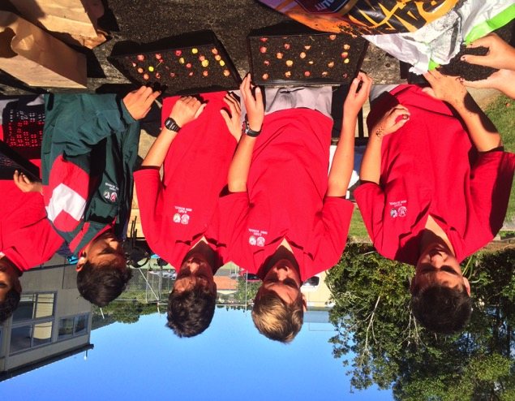
Cross-curricular Environmental Project Based Learning
Action based learning in the local environment

Slide 2
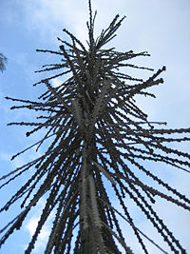
The CEPBL model has evolved out of:
An understanding of why teachers struggle to include vocational and environmental based learning at secondary level.
From observations of some of the general problems in secondary schools.
Research into successful programmes in other countries.
An understanding of NZ and NZers unique environment and culture.
A belief that learning can and should be meaningful and enjoyable and create citizens that can sustain themselves.

Slide 3
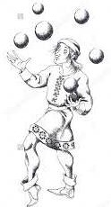
1. Teachers on including practical projects...
‘The timetable is too crowded already’
‘There is not enough money ‘
‘The siloed subject area and hour long periods prevent outdoors projects because of lack of time’
‘It is difficult to link to Achievement Standards to environmental projects’
‘Environmental studies and vocational learning are in addition to and of lesser importance than theory based learning so we have to prioritize the theory which take all our time’
Lone sustainability or enviro teacher and principal turnover

Slide 4
2. General observations of secondary school...
Disengagement of pupils due to siloing of subjects.
Busy, stressed teachers.
Disconnection of theory from practice.
Disconnection between school subjects and local community, environment and industry.
Boredom.
Behavioural problems.
The majority of Maori students and upward of 70% of the rest of our Northland pupils want to stay local but are oriented towards academic subjects aimed at university study.

Slide 5
3. Successful programmes in other countries
Bella Bella
On Heiltsuk land - they had almost no economy, deep social problems and one of the highest youth suicide rates in the country.
Larry Jorgensen arrived and started working with Heiltsuk youth on their land - taking them out, building cabins with them, teaching them about their land.
A science and cultural camp followed and eventually a fully integrated environmental programme.
The graduation rate in Bella Bella is now 85 per cent, up from just two per cent and the community has a growing economy built around ecotourism, aquaculture and forestry.
South Bronx High School
Stephen Ritz changed his programme to integrate gardening as an entry point for all learning.
Since greening his curriculum, Ritz has seen near-perfect attendance and graduation rates, dramatically increased passing rates on state exams, and behavioural incidents cut in half.
In the poorest congressional district in America, he has helped create 2,200 local jobs and built farms and gardens while changing landscapes and mindsets for residents, students, and colleagues.

Slide 6
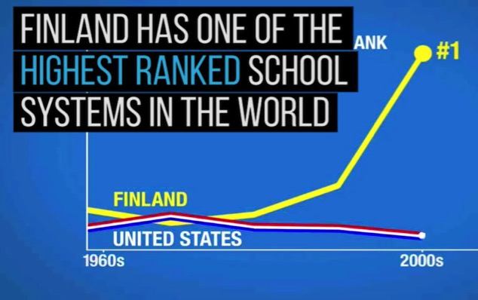
Finland
Phenomenon Based Learning (PhenoBL) - holistic real-world phenomena provide the starting point for learning.
Phenomena are holistic topics like human [rights], European Union, media and technology, water or energy
The phenomena are in their real context, and the information and skills related to them are studied by crossing the boundaries between subjects.
Teachers and students having fun is one of their requisites.

Slide 7
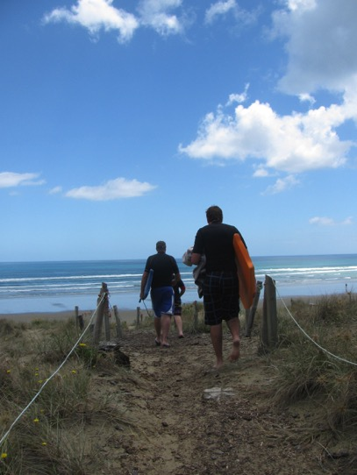
4. And who are we traditionally?
Hunting
Fishing
Surfing
Gardening
Farming
Orchards
Permaculture
Conservationists
Hippy heritage
Boogie boarding
Swimming
Boating
Horse riding
Shellfish gathering
Bush loving
Camping
Bbq/hangi Fresh food fanatics
Bach owning
Beach going
Kayaking
Backyard geniuses

Slide 8
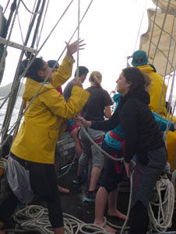
Recent NZ Research
Hitaua Arahanga-Doyle, a researcher at Otago University, measured the positive changes adventure education can foster in youth.
The focus of the study was the seven-day youth voyages on the R. Tucker Thompson, a schooner based in the Bay of Islands.
The youth that take part in the voyages are predominantly Māori and European from Northland.
The findings demonstrated increases in psychological resilience for the youth who undertook the voyage. Increases in resilience seemed to be driven by the collective identity the adolescents formed with their group on the voyage.

Slide 9
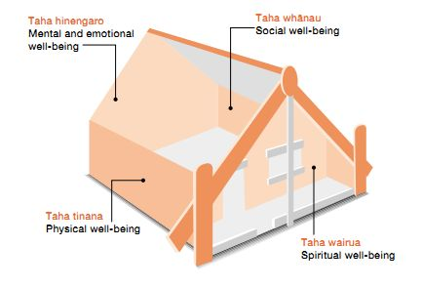
5. Why are we doing this, Miss?
Meaningful learning for meaningful lives

Slide 11
NZ Curriculum Values – do we have a mandate for doing environmental project based learning?
The NZ Curriculum vision states that it intends to produce young people who will be:
The curriculum encourages students to look to the future by exploring future focused issues as sustainability, citizenship, enterprise, and globalisation.
creative, energetic, and enterprising
confident, connected, actively involved, and lifelong learners
contributors to the well being of New Zealand – social, cultural, economic and environmental
connected to the land and environment
members of communities

Slide 12
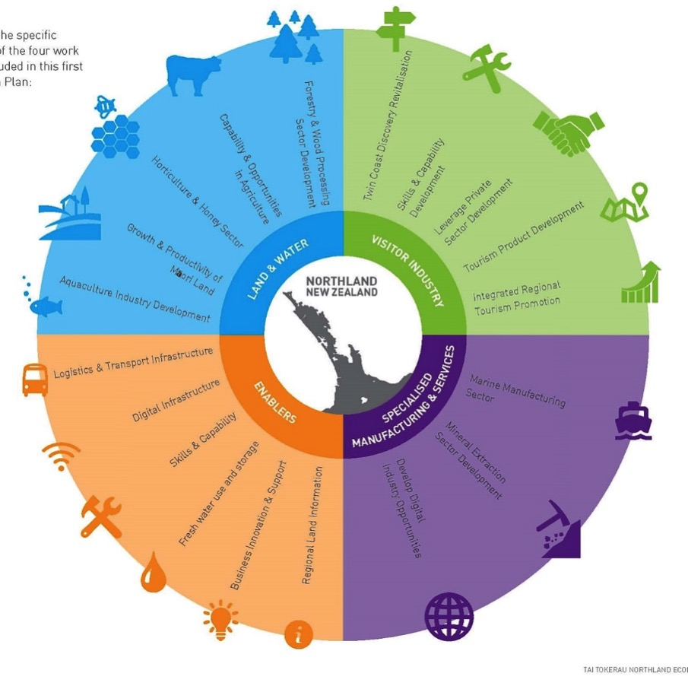
Tai Tokerau Northland Economic Action Plan
Land and Water
Visitor Industry
Manufacturing services - marine industry, etc
Enablers – transport, comms

Slide 13
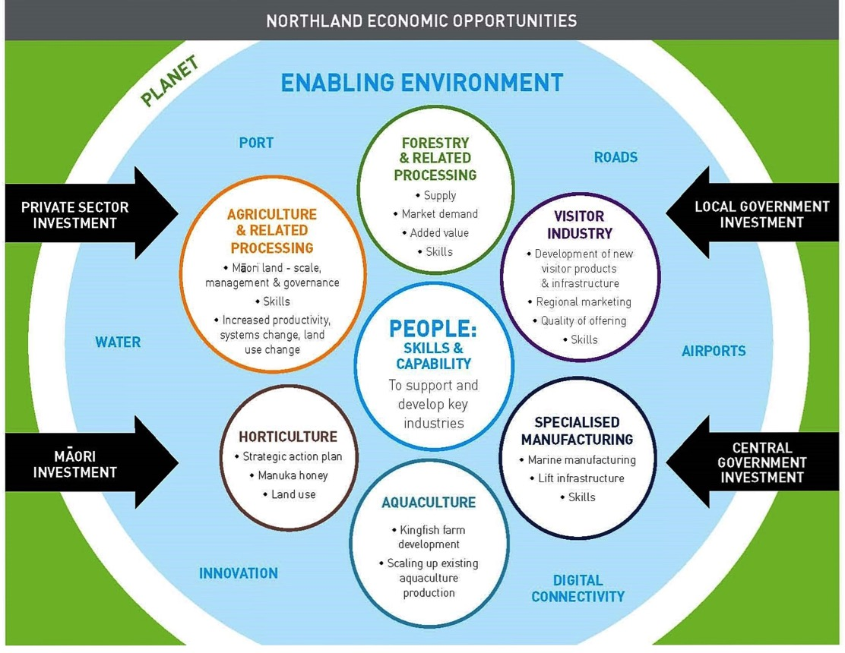
At least five of the seven economic opportunities in Northland are based in the environment and involve a degree of practical, outdoors work.

Slide 14
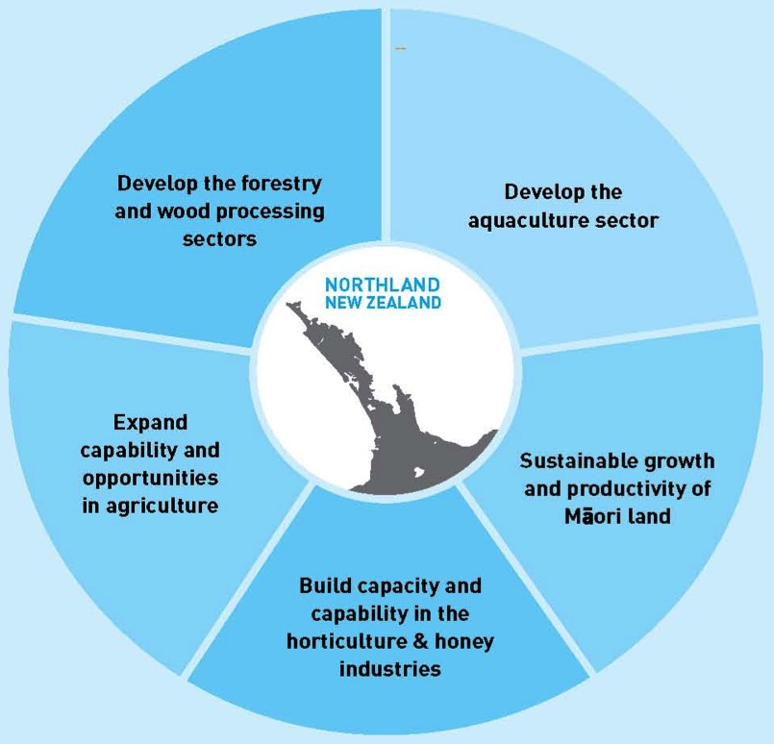
Where development is going – how the future of our local industry is going to look:
Agribusiness AS for year 12 and 13 released this October

Slide 15
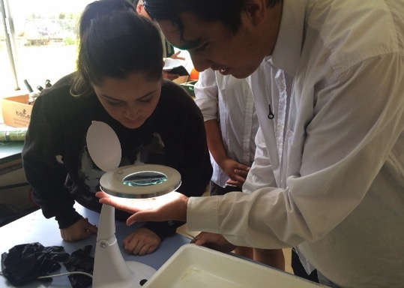
Summarizing: To meet the needs of teachers, industry, community and students we require school programmes that:
Integrate mainstream/theoretical knowledge back into practical experiences.
Take place in the mainstream timetable and are therefore valued and have time to take place rather than with additional teacher in extra curricular times.
Use current teachers and curriculum and funding.
Inspires and guides our young people into careers that reflect who they are, can sustain them as well as the environment and community they live in.
Are inquiry based to some degree and start from the students own knowledge, background and interests to create personal relevance.
FREE
Mangakahia Area School students measure elvers.
Create engaging and enjoyable teaching and learning experiences that prepare young people for working in our industries.
So what might one look like?
Notes:
Tūrangawaewae is one of the most well-known and powerful Māori concepts. Literally tūranga (standing place), waewae (feet), it is often translated as ‘a place to stand’. Tūrangawaewae are places where we feel especially empowered and connected. They are our foundation, our place in the world, our home.

Slide 16
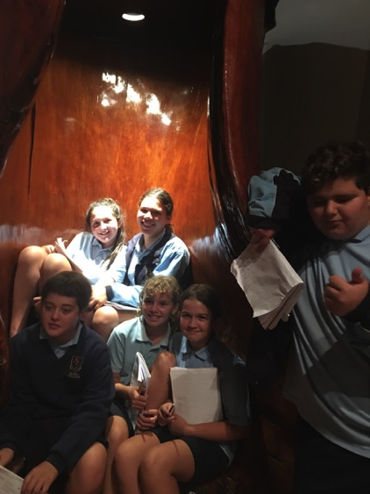
A cross curricular programme across a whole year level
Ruawai College Our Big Blue Back Yard – Junior programme 2017
Start up – Term 1 Identifying the situation
Logging and deforestation of the Kaipara, transportation, population changes, technology changes over time (history, literacy, geography, technology, drama)
Oyster farming, fishing industry, eel farming (ag/hort, science,media commerce, health and safety, numeracy)
Recreational uses (PE, tourism, business studies, media)
Land forms, habitats and species (science, statistics, literacy, numeracy)
Local businesses and community organisations (geography, business studies, tourism)
Term 2/3 Exploring alternatives
Issues – (inquiry based learning) silting, water quality, overfishing, rare species, pest species, human impacts, etc (science, sustainability, statistics, numeracy, economics, drama, critical thinking)
Term 3/4 Taking Action
Actions - Starting with a feasibility study – which issue shall we act on? Eg. lobbying, pest control, tree planting, protecting waterways, etc (ag/hort, vocational learning, problem solving, etc).
Ruawai College students brushing up on their local history at Matakohe Museum
2018 Our Big Green Backyard ...

Slide 17
Explore a Local Industry: Horticulture
Look at the history of your industry – when and where were the plants first grown in NZ?
What improvements have occurred over time – how has technology changed the industry?
What are requirements for propagation of the plants? Maintenance? Grow and look after 10 plants in nursery conditions (Horticulture)
How do the seasons effect the crop, the soil, climate? When is harvest? (Science/Hort)
How is the harvest transported and processed? (Technology)
How was your local example financed? What is their staff and what jobs do they do? How do they find their staff and how is the business structured? What training is required to work in this industry? How have they costed this product? (Commerce/vocational learning)
What promotions and market research were done? How effective was the promotion? Make a promotional flyer for the product. (English/Media)
What waste is created and how is it disposed of? What is the environmental effect of this crop? (Geography/Science/Technology/Learning for Sustainability)
What improvements could be made to reduce the impact on the environment? (Technology/Science/Learning for Sustainability)
Who uses this crop and for what? Create a new recipe using this product. (Food tech)

Slide 18
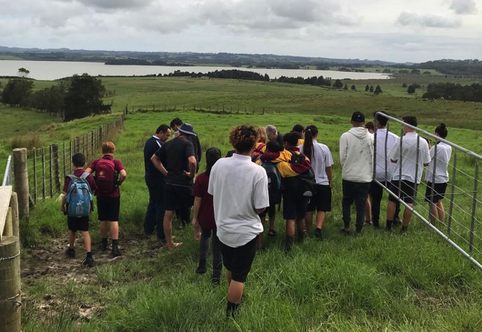
Kaikohe Christian School - Whole school approach
Term 1 – Deciding the focus
Visits to local areas of significance and industry by students: Lake Omapere, Pioneer Village, Ngawha geothermal energy and pools etc
Students feed back to teachers on areas of interest
Projects areas decided and developed across the curriculum as a whole staff
Kaikohe Christian School students history lesson at Lake Omapere with local iwi.

Slide 19
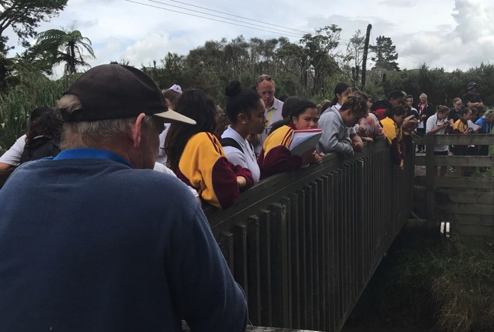
Term 1/Term 2
In depth study of the focus area across the curriculum – visit, learn the history and present state of the lake, gather info from NRC, iwi, local farmers and other stakeholders.
Term 2/Term 3 Exploring alternatives
Exploring the issues in their locality and how things could be improved - water quality, the effects of deforestation and farming.
Term 3/Term 4 Taking Action
Taking action – develop a response to the issue – planting for improved water quality, developing sustainable communities, lobbying for change etc
Kaikohe Christian School students observe water condition in a tributary stream to lake Omapere.

Slide 20
Whangarei Girl’s High - multi level cross-curricular engagement with Bream Head Reserve
Staff were engaged and familiarised with the secondary study units developed by Enviroschools facilitator Jacque Knight fo the Bream Head Reserve Trust and to engage schools in the development of the reserve.
Departments involved: Primary industries, Science and Social science (year 9), Ag hort, and Design (Yrs 11-13)
Identifying the situation -Visits to the reserve by students with experts in geology, local Maori and European history, agriculture, marine industry, bush restoration and landscape design on site delivering information
Whangarei Girl’s High students learn about invasive pests and pest control by playing the pest control game with Bream Head Reserve ranger Adam Willets

Slide 21
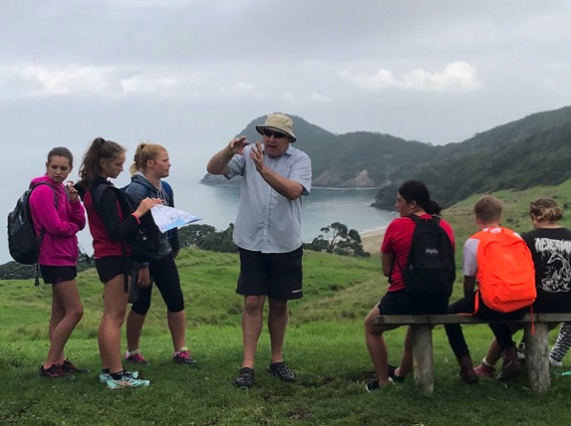
Exploring Alternatives - Further study back in class – Social science (engaging and assessing the response of the community to proposed developments), Ag/hort and primary industries (learning about water quality on farms and potential solutions, plant id and propagation, marine pests etc), Design (designing teaching hub, learning about building permission process, consents, etc)
Whangarei Girl’s High students learn about the archaeology and human history of the Bream Head reserve area.
Taking Action - Further visits to fence and plant waterways and wetlands, build tracks, dive trips, make plant id walk interview community, make presentations (building prototypes, community engagement), surveying

Slide 22
Bream Head Conservation Trust – Introductory unit
Guided Inquiry Questions | Activity Possibilities | Resources | Assessment Opportunities
 |  |  | Level 1 | Level 2 | Level 3
What is the geology and other prehumen history of the area? What is the prehuman ecology of the area? | Research the volcanic origins of the area and any other geological formations and fossils and then walk in and collect photographic evidence – map the position of your finds. Talk to the Bream Head Conservation ranger about the bush and land before human habitation. Find information from at least two other sources regarding prehumen ecology. What changes to ecology have happened to our ecology between then and now? Create a visual presentation/write a report on the prehistory of the area | http://www.doc.govt.nz/Documents/conservation/land-and-freshwater/land/manaia-ecological-district/manaia-ecological-disctrict.pdf http://www.doc.govt.nz/biodiversity | Science AS 90952 Demonstrate understanding of the formation of surface features in our area: Let’s Look at Our Local Area English/Media/IT Create a visual presentation AS 90853 Use information skills to form conclusion(s) | Science AS 91189 Investigate geological processes in a New Zealand locality responsibility model in physical activity English/Media/IT Create a visual presentation AS 91105 Use information literacy skills to form developed conclusions | Science AS 91410 Carry out an independent practical Earth and Space Science investigation Ag/Hort US 29414 Describe and use a Global Positioning System (GPS) for a specified rural activity management strategies AS 91505 Examine contemporary leadership principles applied in physical activity contexts English/Media/IT Create a visual presentation US Read texts to research information US 11097 Listen actively to gain information in an interactive situation US 3491 Write a report

Slide 23
Guided Inquiry Questions | Activity Possibilities | Resources | Assessment Opportunities
 |  |  | Level 1 | Level 2 | Level 3
How long has the area been inhabited by humans? Who were they and when did they come? How did they survive (food, shelter, trade, defence)? | Look at middens and pa sites and identify what is in them Listen to a local iwi member and other local historians relating the history of the area Visit sites of significance to people in the past on the reserve Find out the local legends and then create art work to represent it. Create a timeline. | http://www.doc.govt.nz/Documents/conservation/historic/by-region/northland/bream-head-heritage-assessment.pdf | Social Science AS 91011 Conduct geographic research with direction History AS 91001 Carry out an investigation of an historical event, or place, of significance to New Zealanders AS 91002 Demonstrate understanding of an historical event, or place, of significance to New Zealanders AS 91004 Demonstrate understanding of different perspectives of people in an historical event of significance to New Zealanders Art AS 90914 Use drawing methods and skills for recording information using wet and dry media | Social Science AS 91240 Demonstrate geographic understanding of a large natural environment AS 91243 Apply geography concepts and skills to demonstrate understanding of a given environment History AS 91229 Carry out an investigation of an historical event, or place, of significance to New Zealanders AS 91230 Demonstrate understanding of an historical event, or place, of significance to New Zealanders AS 91232 Demonstrate understanding of different perspectives of people in an historical event of significance to New Zealanders | Social Science AS 91246 Demonstrate understanding of how interacting natural processes shape a New Zealand geographic environment History AS 91434 Research an historical event or place of significance to New Zealanders, using primary and secondary sources AS 91435 Analyse an historical event, or place, of significance to New Zealanders English Art 91445 – 91449 Demonstrate conventions of design, photography, sculpture or printmaking

Slide 24
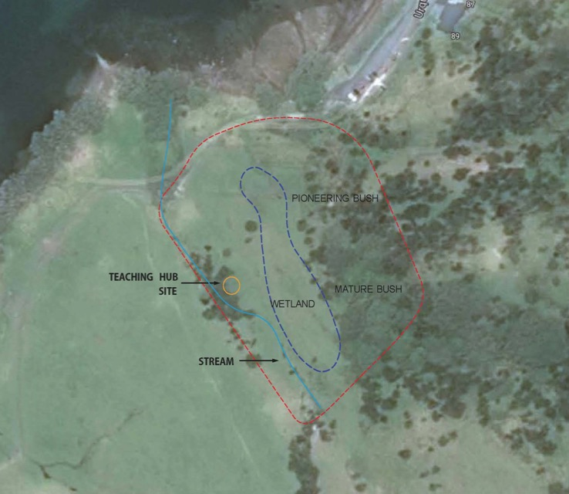
Bream Head Conservation Trust - Other curriculum linked units
Teaching hub – plan and build a hub that will enable students to come out and learn under shelter on site
Plant ID walk – plan and build a track that identifies a variety of native plants
Streamside planting – identify pioneering streamside species of native plants,grow them and plant the stream - side on site.
Wetland planting – identify wetland species of native plants,grow them and replant the wetland on site.
2019 Units Save a Species and Water Quality

Slide 25
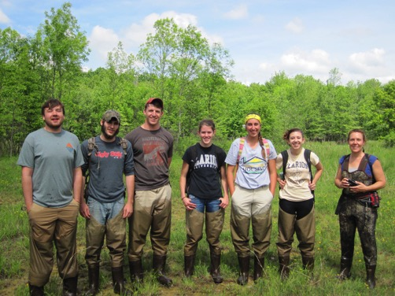
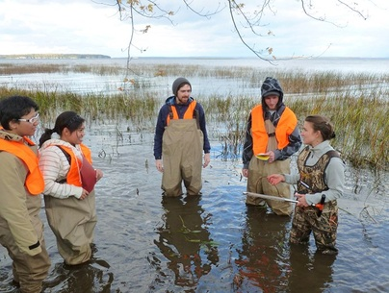
Logistics - Practical Projects Take Longer
How can you fit the following in your senior school day?
Regularly leave the classroom to visit industry
Restoring a wetland
Tend a plant nursery or an orchard
Have a community member come in and do a practical demo
Build something to demonstrate the use of maths or science theory
Catch possums
Run an on site café using vegetables grown on site

Slide 26
The Answer - not in one hour slots and not with siloed departments
Possibilities:
Project days or mornings
Project week at the start of a new project
Some weeks or part weeks throughout the term which have longer time periods
Team teaching in longer periods of time allowing team trips
Having home classes with teachers moving rather than students
Necessities:
Regular cross departmental communication
Partnerships with industry and community
Steve, local retiree and environmental volunteer helps out with growing plants at Kamo High
Auckland secondary schools using some of these methods: Alfriston College, Albany Senior High School, Western Springs College

Slide 27
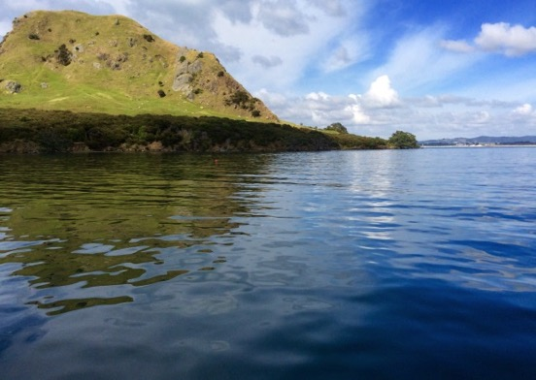
Starting off with project development
Study the local environment: physical, industry, work places, history and community.
Teachers list hobbies and interests.
List stakeholders and useful local people: community and industry leaders, business owners, councils, DOC, iwi and so on
Link your project to the curriculum across the subject areas of the teachers engaged
Identify learning activities.
Identify assessment opportunities.
Have teachers meet regularly to so they know what other teachers are doing and reflect on what is going well and what is not.

Slide 28
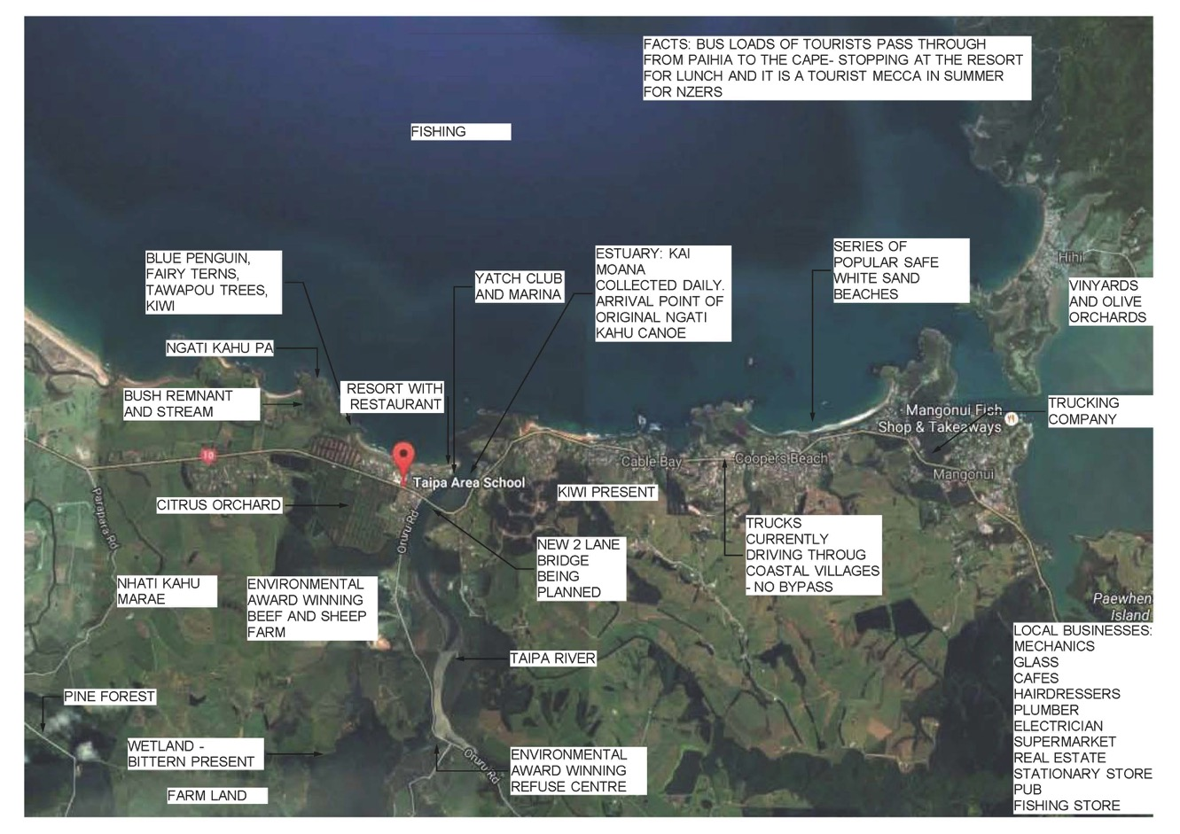

Slide 29
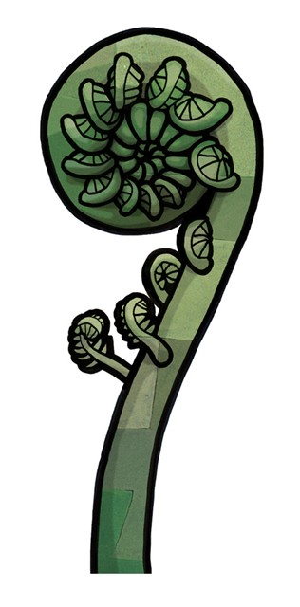
Project Development Activity
Move into small groups.
List three personal interests each – things you do without pay, for fun.
Look at the map and see what is in this location.
Using at least one interest from each of your lists and two facts from the map brainstorm 3 possible projects that could be done in this location.
Identify different secondary subject areas that could be involved in each project and what part of the project they might do.
Think of three learning activities that would be relevant and fun within these projects.

Slide 30
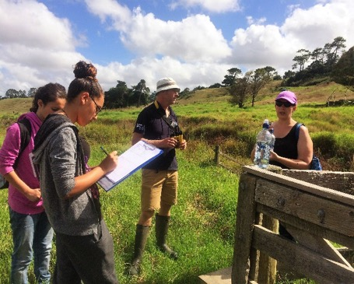
The teacher as facilitator using supporting programmes and organisations.
Agribusiness AS for year 12 and 13 released last October (Kerrie Allen, St Paul’s Collegiate)
Young Enterprise (St Pauls students won the YE award last year for the agribusiness they developed)
Youth Guarantee – Min of Ed linking secondary students to vocations
Regional Councils and DOC – both have become recently more heavily involved in education and with schools
Enviroschools and EFS standards
Local organisations: Experiencing Marine Reserves, Whitebait connection, Bream Head Conservation Trust, landcare and other community groups.
Dargaville High science students monitoring bittern – a partnership between DOC, NRC, community, farmer and the school
And much, much more...

Slide 31
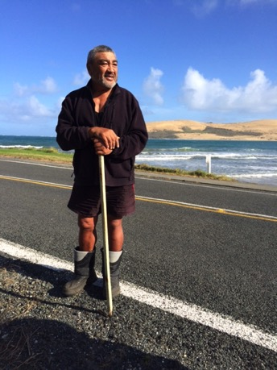
How enviroschools can support your projects
PD days – guiding teachers and students though the process
Resource development support – linking environmental projects to the curriculum and to the action learning cycle.
Finding funding and assisting with applications
Helping link with industry, NRC, DOC and other supporting programmes and community leaders
Reflection- ongoing support to overcome obstacles and refine.
Matua Toi relating the history of the Waiaroha river to Opononi Area School students and staff

Slide 32
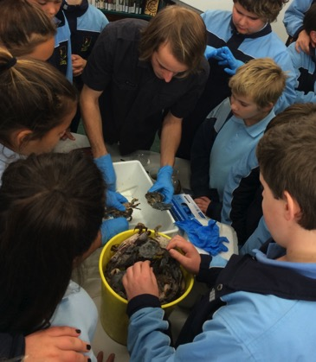
The beauty of CEPBL is...
Environmental and vocational education happens within the curriculum:
Students know their local industries and employers and have industry related experience before they leave school
Teaching is integrated into and effectively utilizes the community, industry and the environment in a shared effort
Less pressure for extra teachers or teacher time
Invigorating and engaging for both teachers and students
Less time is wasted moving from class to class each hour, continuity of learning and real life outcomes
Engagement improvement for boys and Maori students
There is less need for expensive vocational schools and the stigma of ‘vocational’ vs academic is removed
Ruawai Students dissecting invasive Asian paddle crabs from the Kaipara Harbour – Josh’s whose dad is a fisherman, brought them in.

