Slide 1
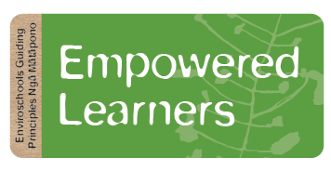
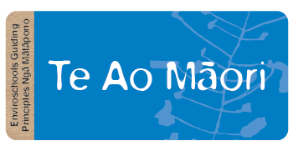
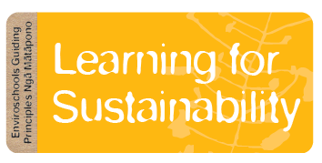
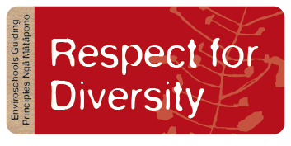
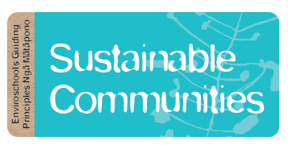
Notes:
The Enviroschools kaupapa is about creating a healthy, peaceful, sustainable world through learning and taking action together.
Our Kaupapa guides all that we do and is embodied in five guiding principles that underpin the whole Enviroschools journey:
Empowered Learners participate in meaningful ways in their community. Their unique perspectives and questions are valued and honoured. They feel connected to the whenua and support each other as a learning community to create meaningful change and hopeful action.
Learning for Sustainability is a holistic, action and future-focused approach to learning, that engages our whole selves and addresses all aspects of our local and global environment.
Te Ao Māori honours tangata whenua of this land. When we are envisioning and taking action for a sustainable future in our community, we are doing so alongside local hapū.
Respect for Diversity is celebrated, and all forms of identity and ability are respected. Cultural traditions and practices from all people are experienced, valued and appreciated in learning spaces, honouring practices led by that community. Access to safe and engaging learning is available to everyone.
Sustainable Communities act in ways that nurture all aspects of nature, including people, now and in the future. By working together and supporting each other we create safe, healthy, equitable and thriving communities.

Slide 2
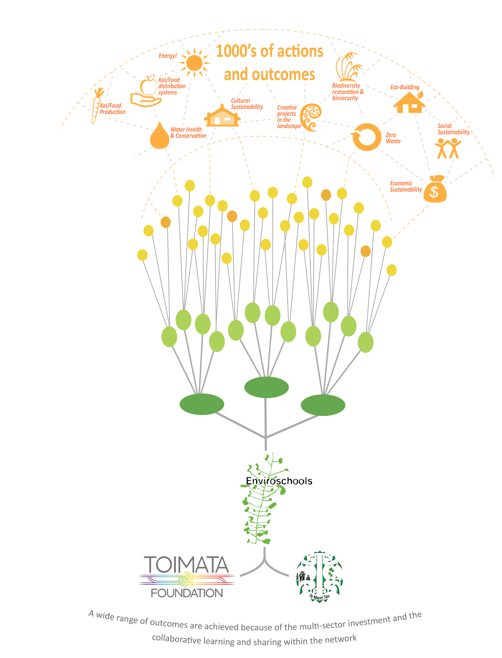
Collaboration
Wider community
Schools and centres
Regional co-funding
National hub
Notes:
Enviroschools is a nationwide programme supported by Toimata Foundation, founding partner Te Mauri Tau, and a large network of regional partners. Early childhood centres and schools commit to a long-term sustainability journey, where tamariki/students connect with and explore the environment, then plan, design and take action in their local places in collaboration with their communities.
Over the last 20 plus years a collaborative support structure has been created resulting in 1000s of community sustainability actions and outcomes that WRC could not achieve solely on our own.
The Waikato team benefits from a strong foundation at the national base with Toimata Foundation and Te Mauri Tau providing curriculum linked Aotearoa specific resources, connection and training for passionate facilitators.
A co-funding approach with territorial authority partners in Waikato creates a localised, facilitated experience in over 150 Enviroschools across the region – about 50% of Waikato schools.

Slide 3
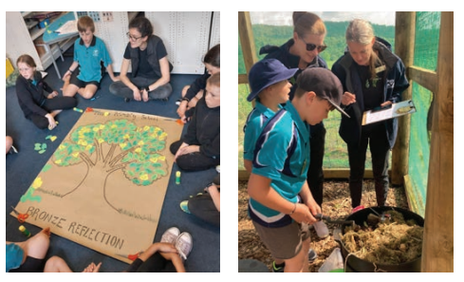
“Enviroschools offers high-quality facilitation, and the work of the facilitators is key to successful programme delivery. Teachers value the holistic nature of the programme and can point to examples of deep holistic learning in schools. Reflective practice is intrinsic to the programme at all levels, building awareness of what’s happening, supporting the celebration of what has been achieved and is useful for informing decisions about next steps.” Evaluation of Waikato Enviroschools programme 2023
Notes:
Curriculum linked resources are unpacked for teachers through professional learning opportunities
Reflection is an important part of the enviroschools journey – pausing to celebrate and to determine next steps.

Slide 4
Notes:
Every school is unique, with its own ecology, history, culture and community – so Enviroschools looks different in every setting.
The journey of connecting with the place and its people is designed and led by each school or centre.
Experience has shown that the components of the Enviroschools process are not linear – they overlap, are revisited, modified and further developed, supporting schools and centres to develop their own holistic approach that deepens over time.

Slide 5
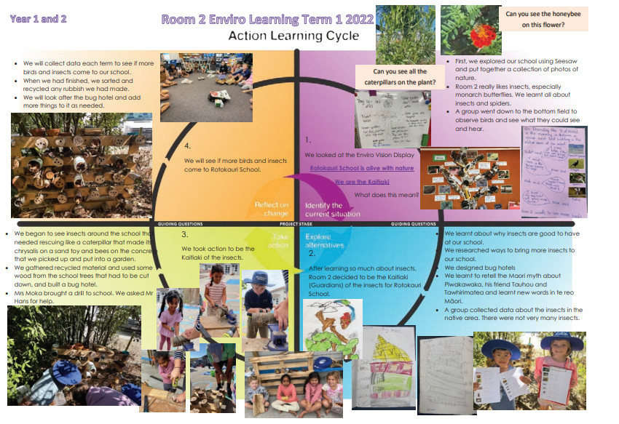
Action Enquiry
Notes:
At the heart of Enviroschools is the Action Learning Cycle, encouraging an enquiry-based process of exploration, decision-making, design, action and reflection. It is a key tool that can be applied to a specific project or an entire process in an Enviroschools Journey.
Here is an example of how this is used: Inn 2021, Rotokauri School were new to Enviroschools and embarked on a process to create a whole-school vision.
Each class took part in identifying ideas that were important to them, and changes they’d like to see around the school, to help develop a vision statement.
“Rotokauri is alive with nature. We are kaitiaki – actively caring and nurturing our place and our people. Our school is welcoming and colourful. We are a peaceful, sharing community. We would love for you to be part of our creative vision – to promote change in our school, our community and our world”.
From this, 10 big idea statements were developed to convey how their vision could be achieved, and planning began at the start of 2022 to put these statements into practice.
Projects were allocated to different year groups to get the whole school involved.
Year 1 and 2 students focus on being kaitiaki of the environment, making bug hotels and developing a garden for kai and scented herbs
Year 3 and 4 students concentrated on building connections with the community, creating links with the nearby Hamilton Zoo by exploring ways to create enrichment toys for the animals.
Year 5 and 6 created new school vegetable beds with funding from Waikato Regional Council’s Envirofund, and began to realise their vision for sustainable growing.
Year 7 and 8, meanwhile, dug deep with a soil investigation. They looked at what makes soil healthy, using their learnings to grow an abundance of fresh vege in existing beds, and entered the Enviroschools Mara Kai Challenge.

Slide 6
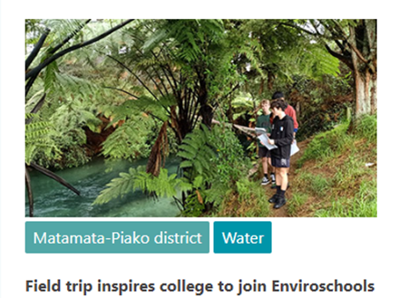
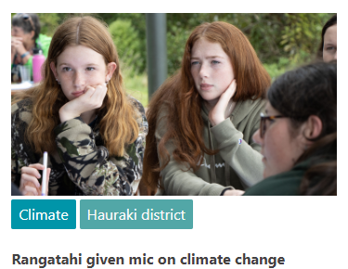
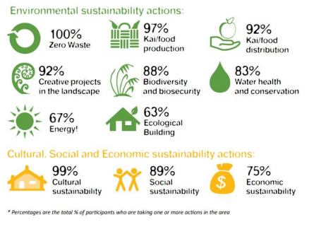
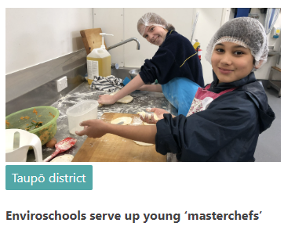
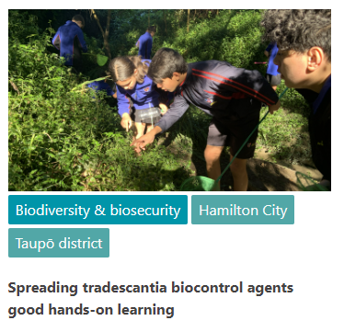
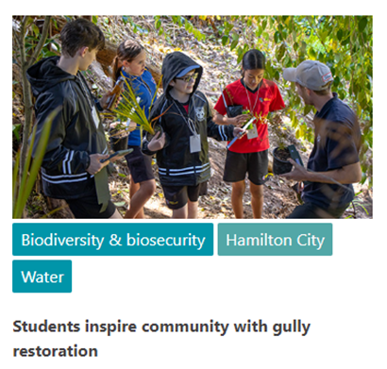
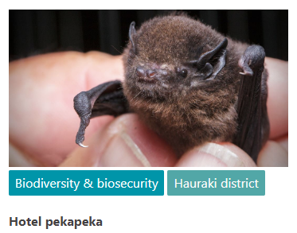
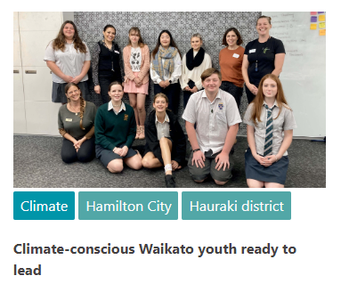
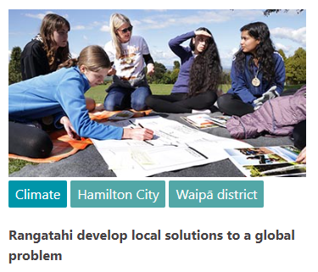
“Enviroschools is empowering people, particularly students and teachers, to take action that benefits their environment. All strands of evidence support our finding that there are high levels of engagement in environmental action reporting. Further, the evaluation evidence suggests that Enviroschools is influencing teaching and learning within some schools.”
Evaluation of Waikato Enviroschools programme 2023
Notes:
We know that Enviroschools is effective by the stories that are shared that inspire the network and celebrate school journeys.
Regular evaluation is carried out via Toimata Foundation and at Regional Council will outcomes links to the local government act and feedback received by teachers.

