Slide 1
St Teresa’s School
Green-Gold Reflection

Slide 2
Notes:
Opening waiata – Motupōhue E.

Slide 3
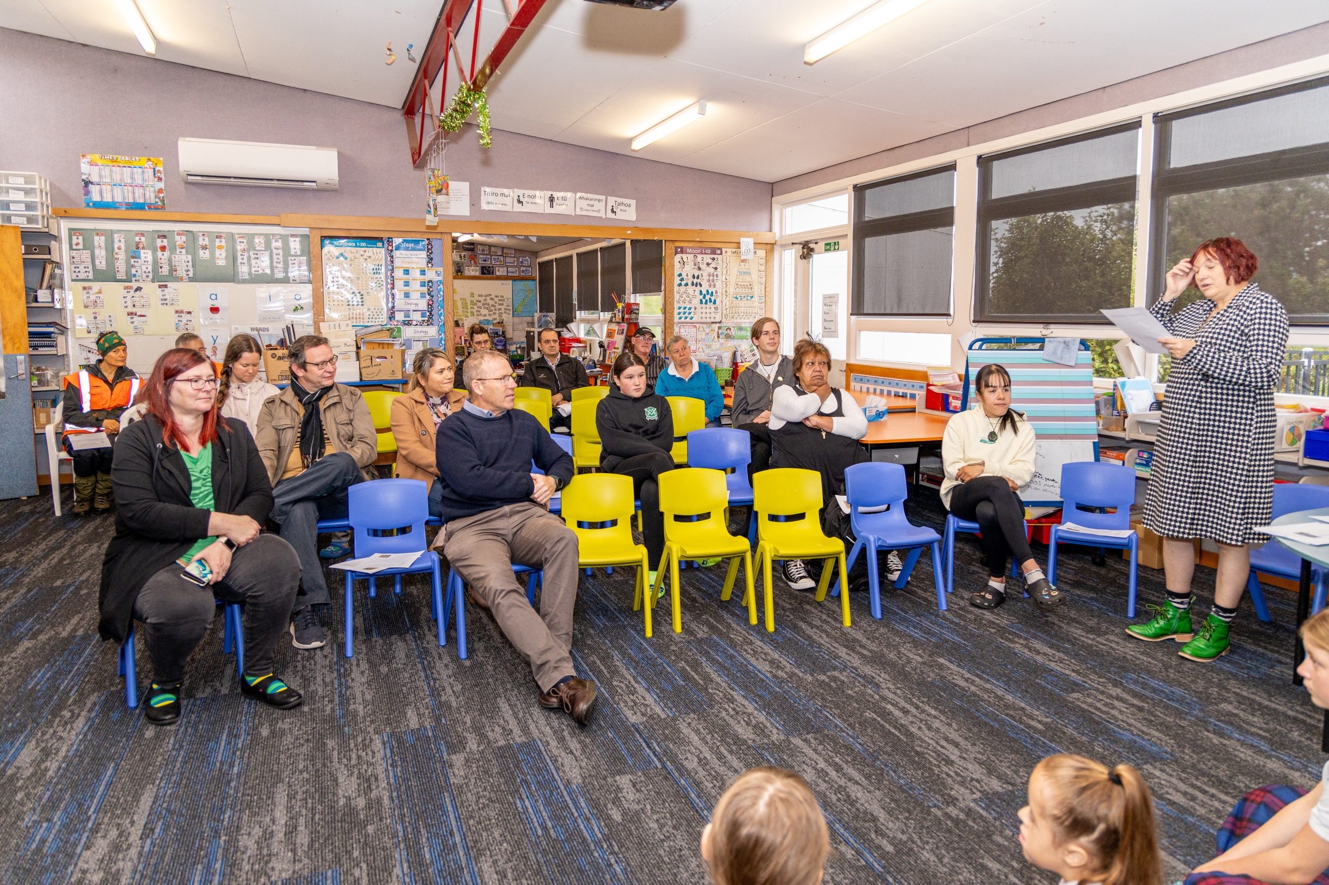
Notes:
Rosi’s welcoming speech.

Slide 4
Notes:
Rosi’s acknowledging the hard mahi of ngā tamariki.

Slide 5
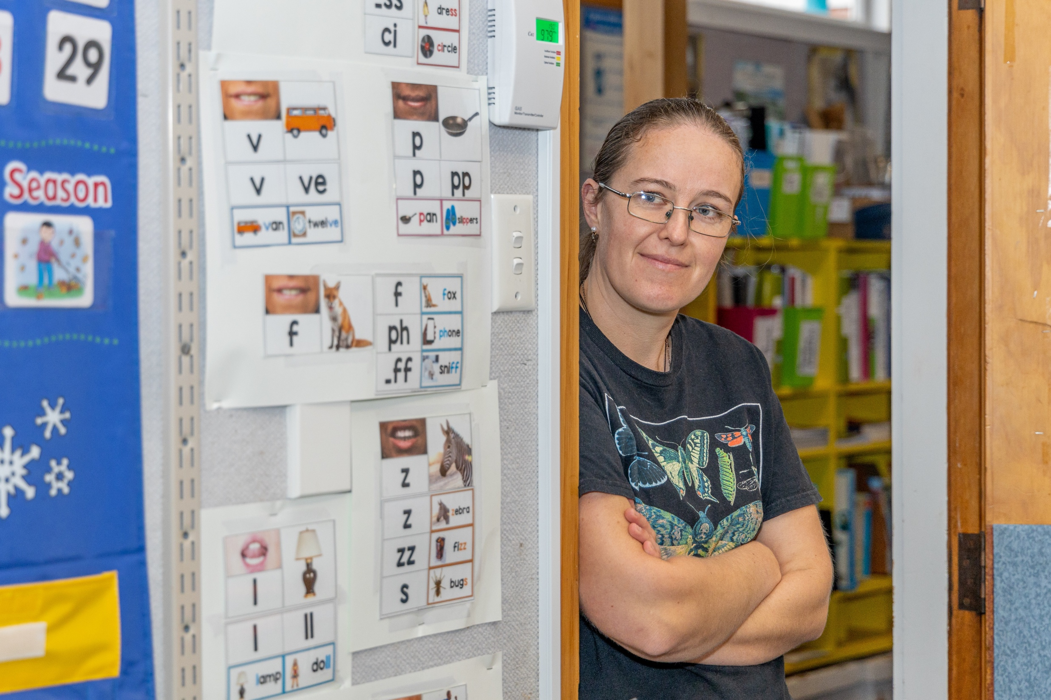
Notes:
Proud support staff member looking on.

Slide 6
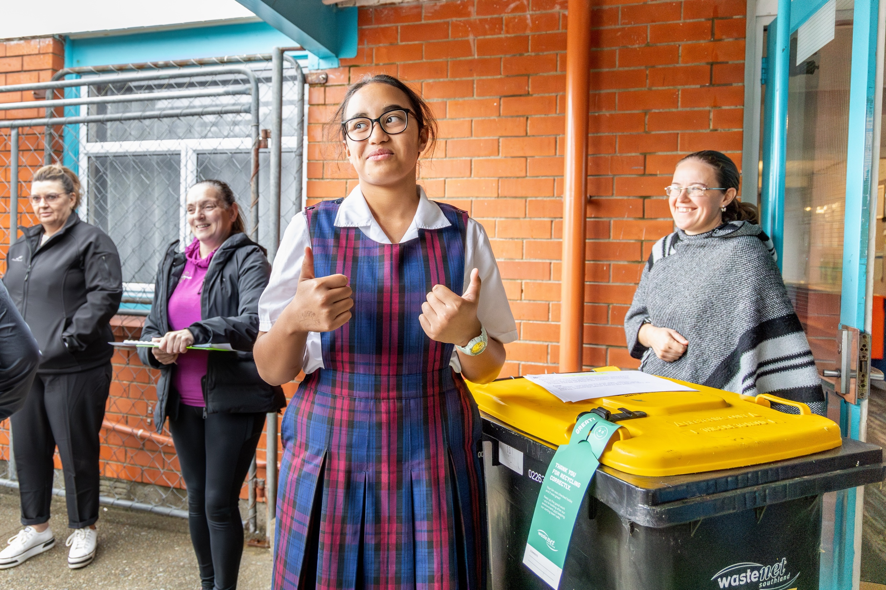
Notes:
Good job on the recycling!

Slide 7
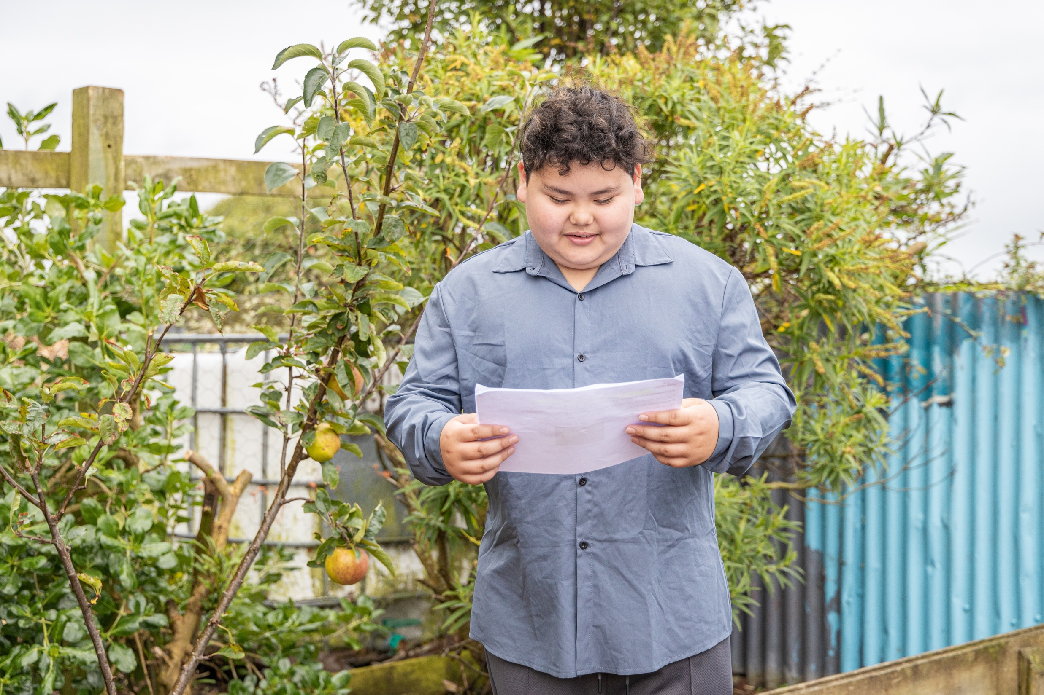
Notes:
Explanation of how the heritage apple trees are used and cared for.

Slide 8
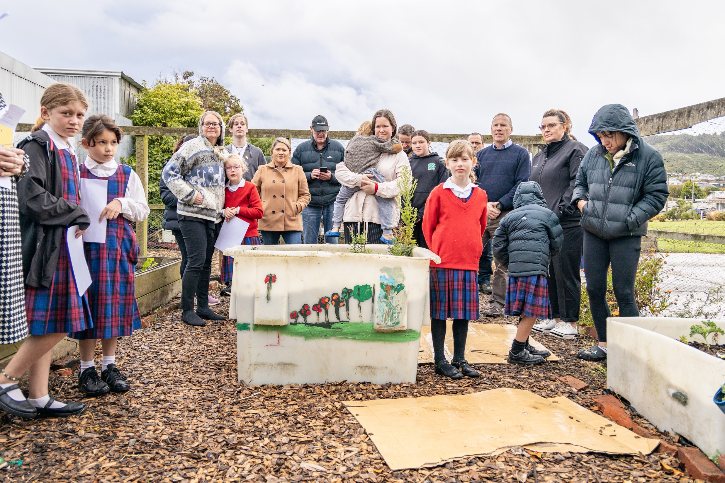
Notes:
Tour of the bee-friendly, herb and vegetable gardens.

Slide 9
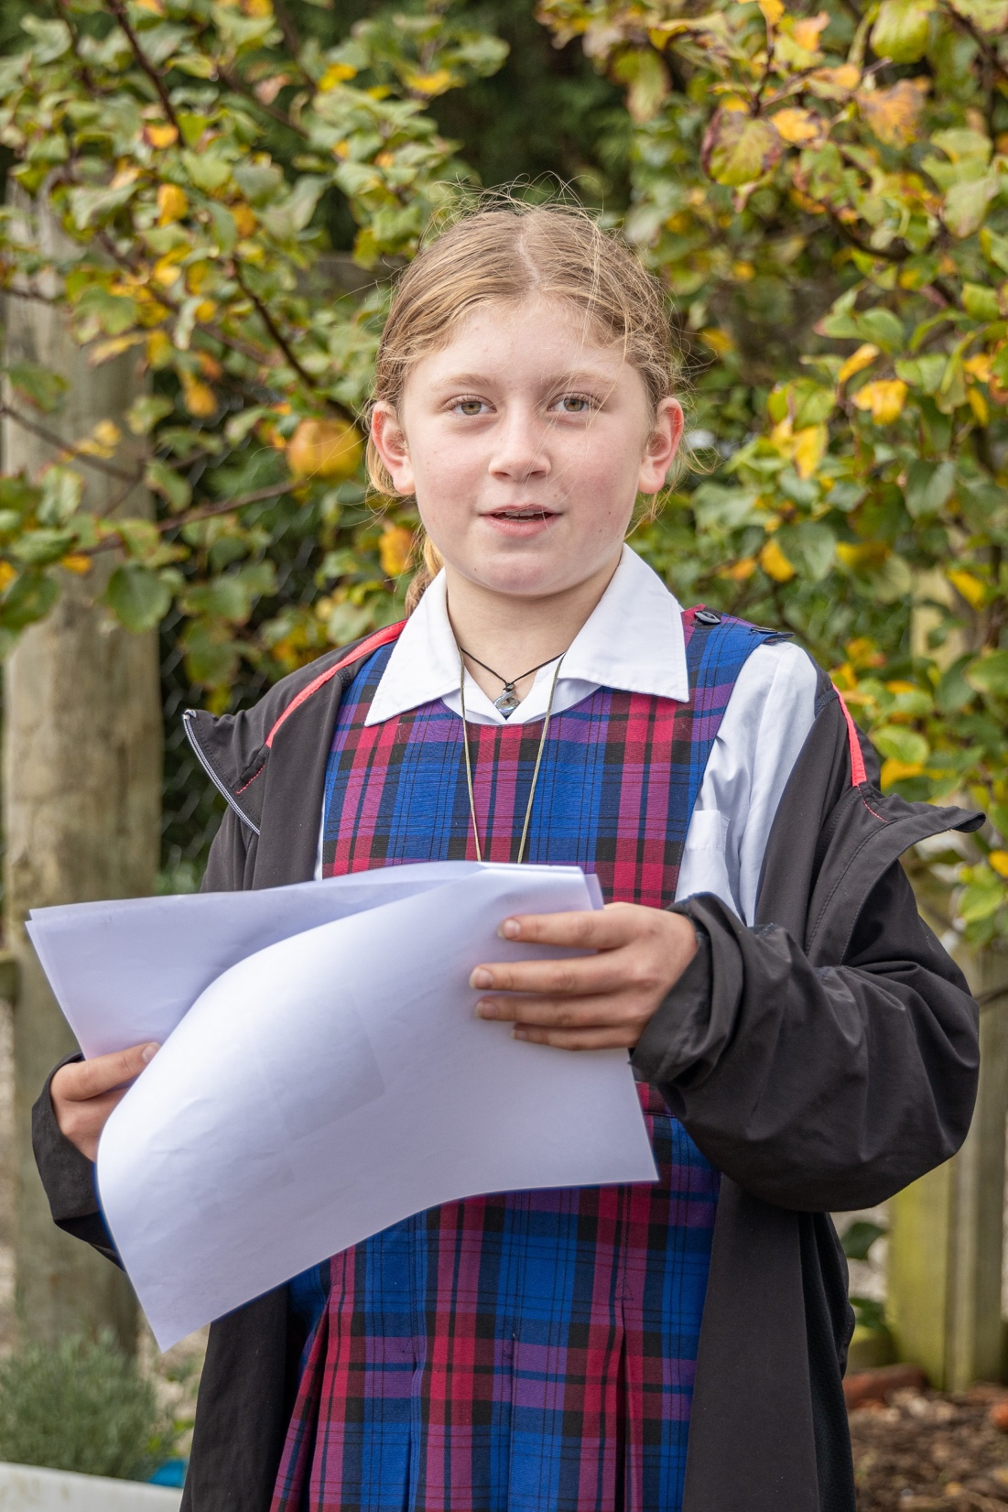
Notes:
Learnings and journeys from the vegetable and herb gardens. Mint WILL take over!

Slide 10
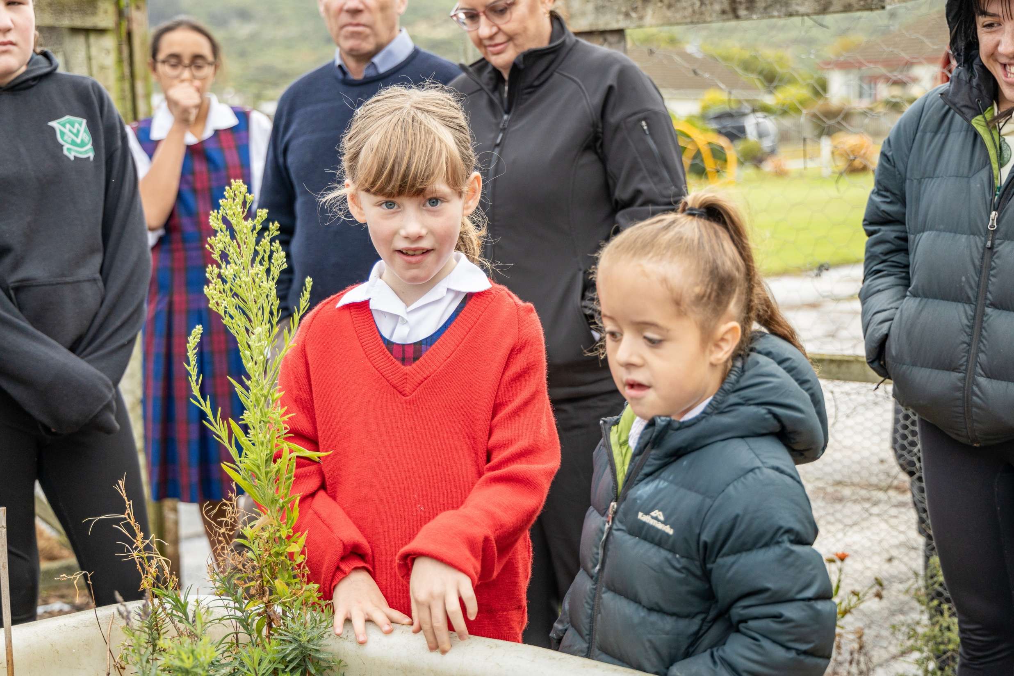
Notes:
Lessons from the bee-friendly garden.

Slide 11
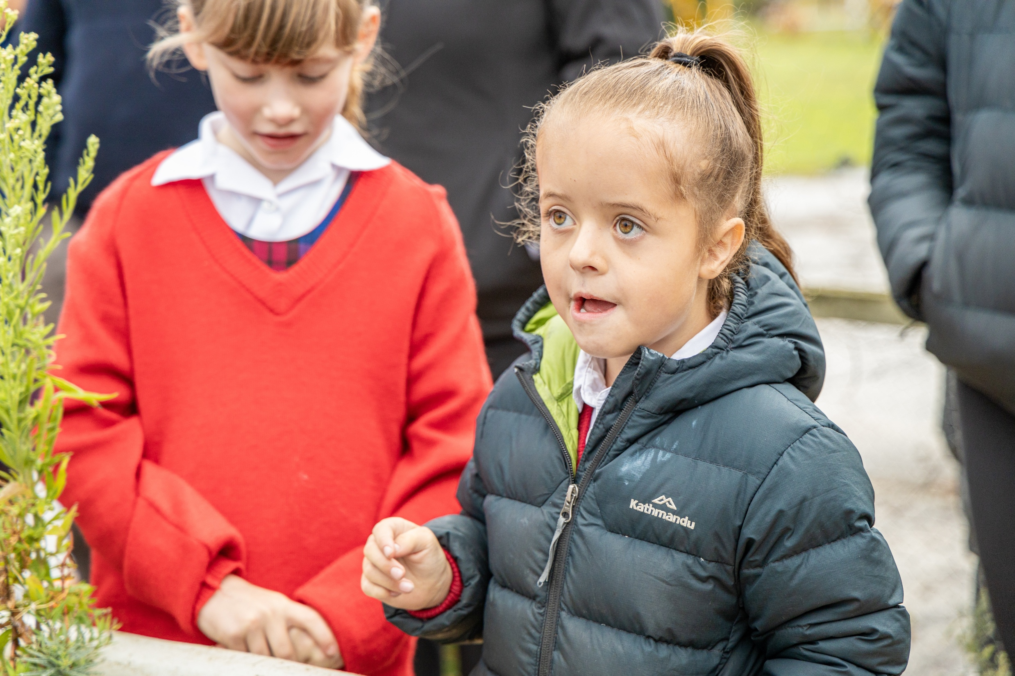
Notes:
Important facts about bees.

Slide 12
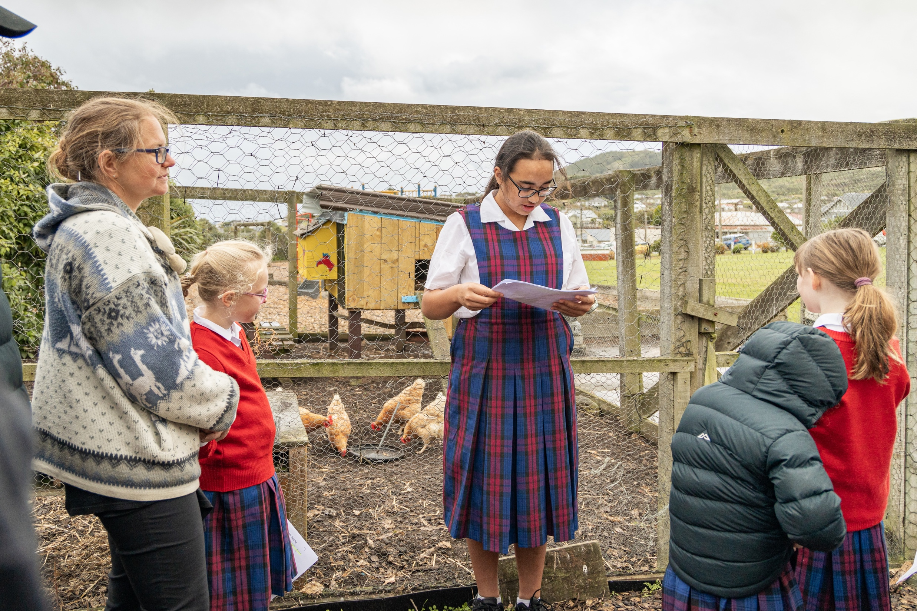
Notes:
The chicken coop.

Slide 13
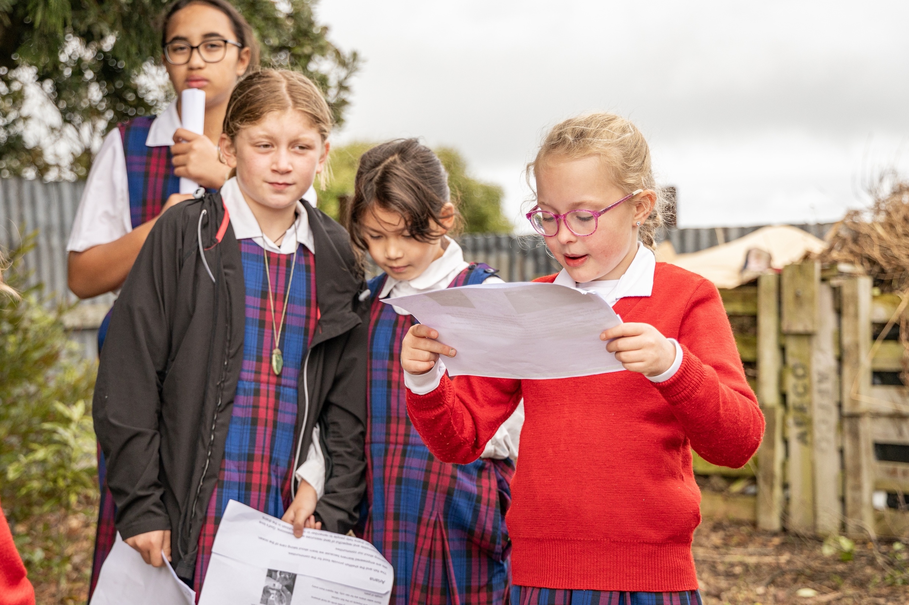
Notes:
The rongōa garden.

Slide 14
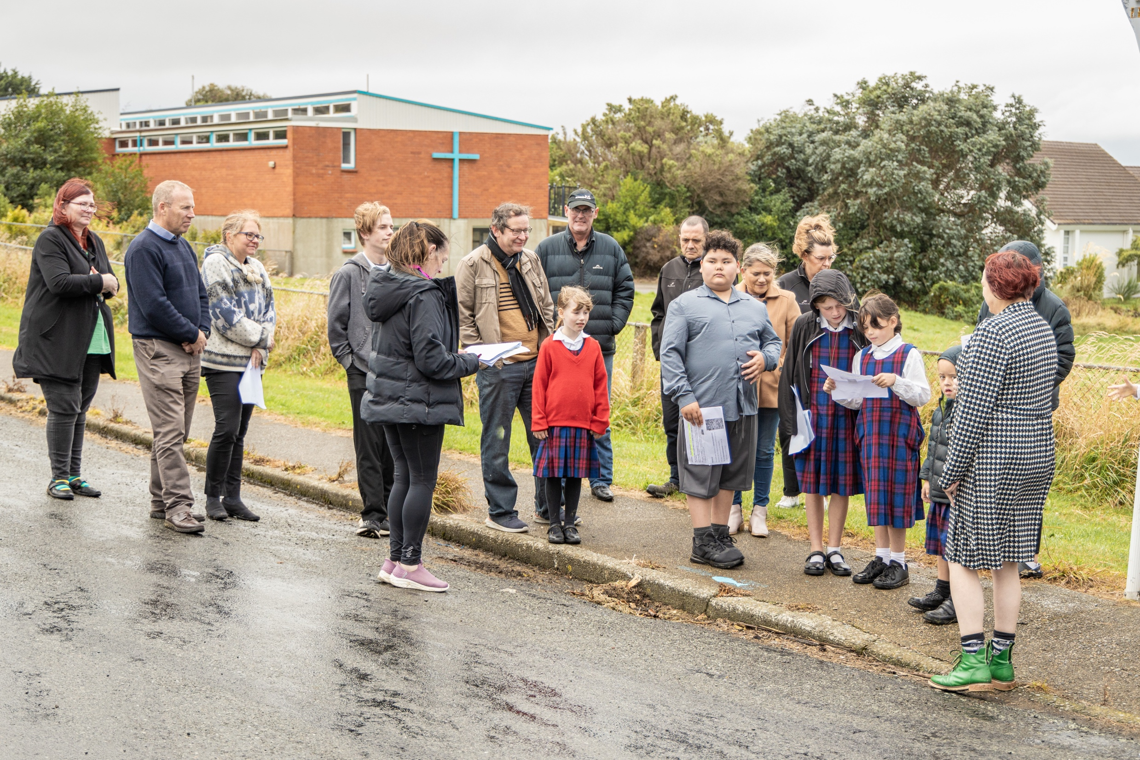
Notes:
Fish on Drains.

Slide 15
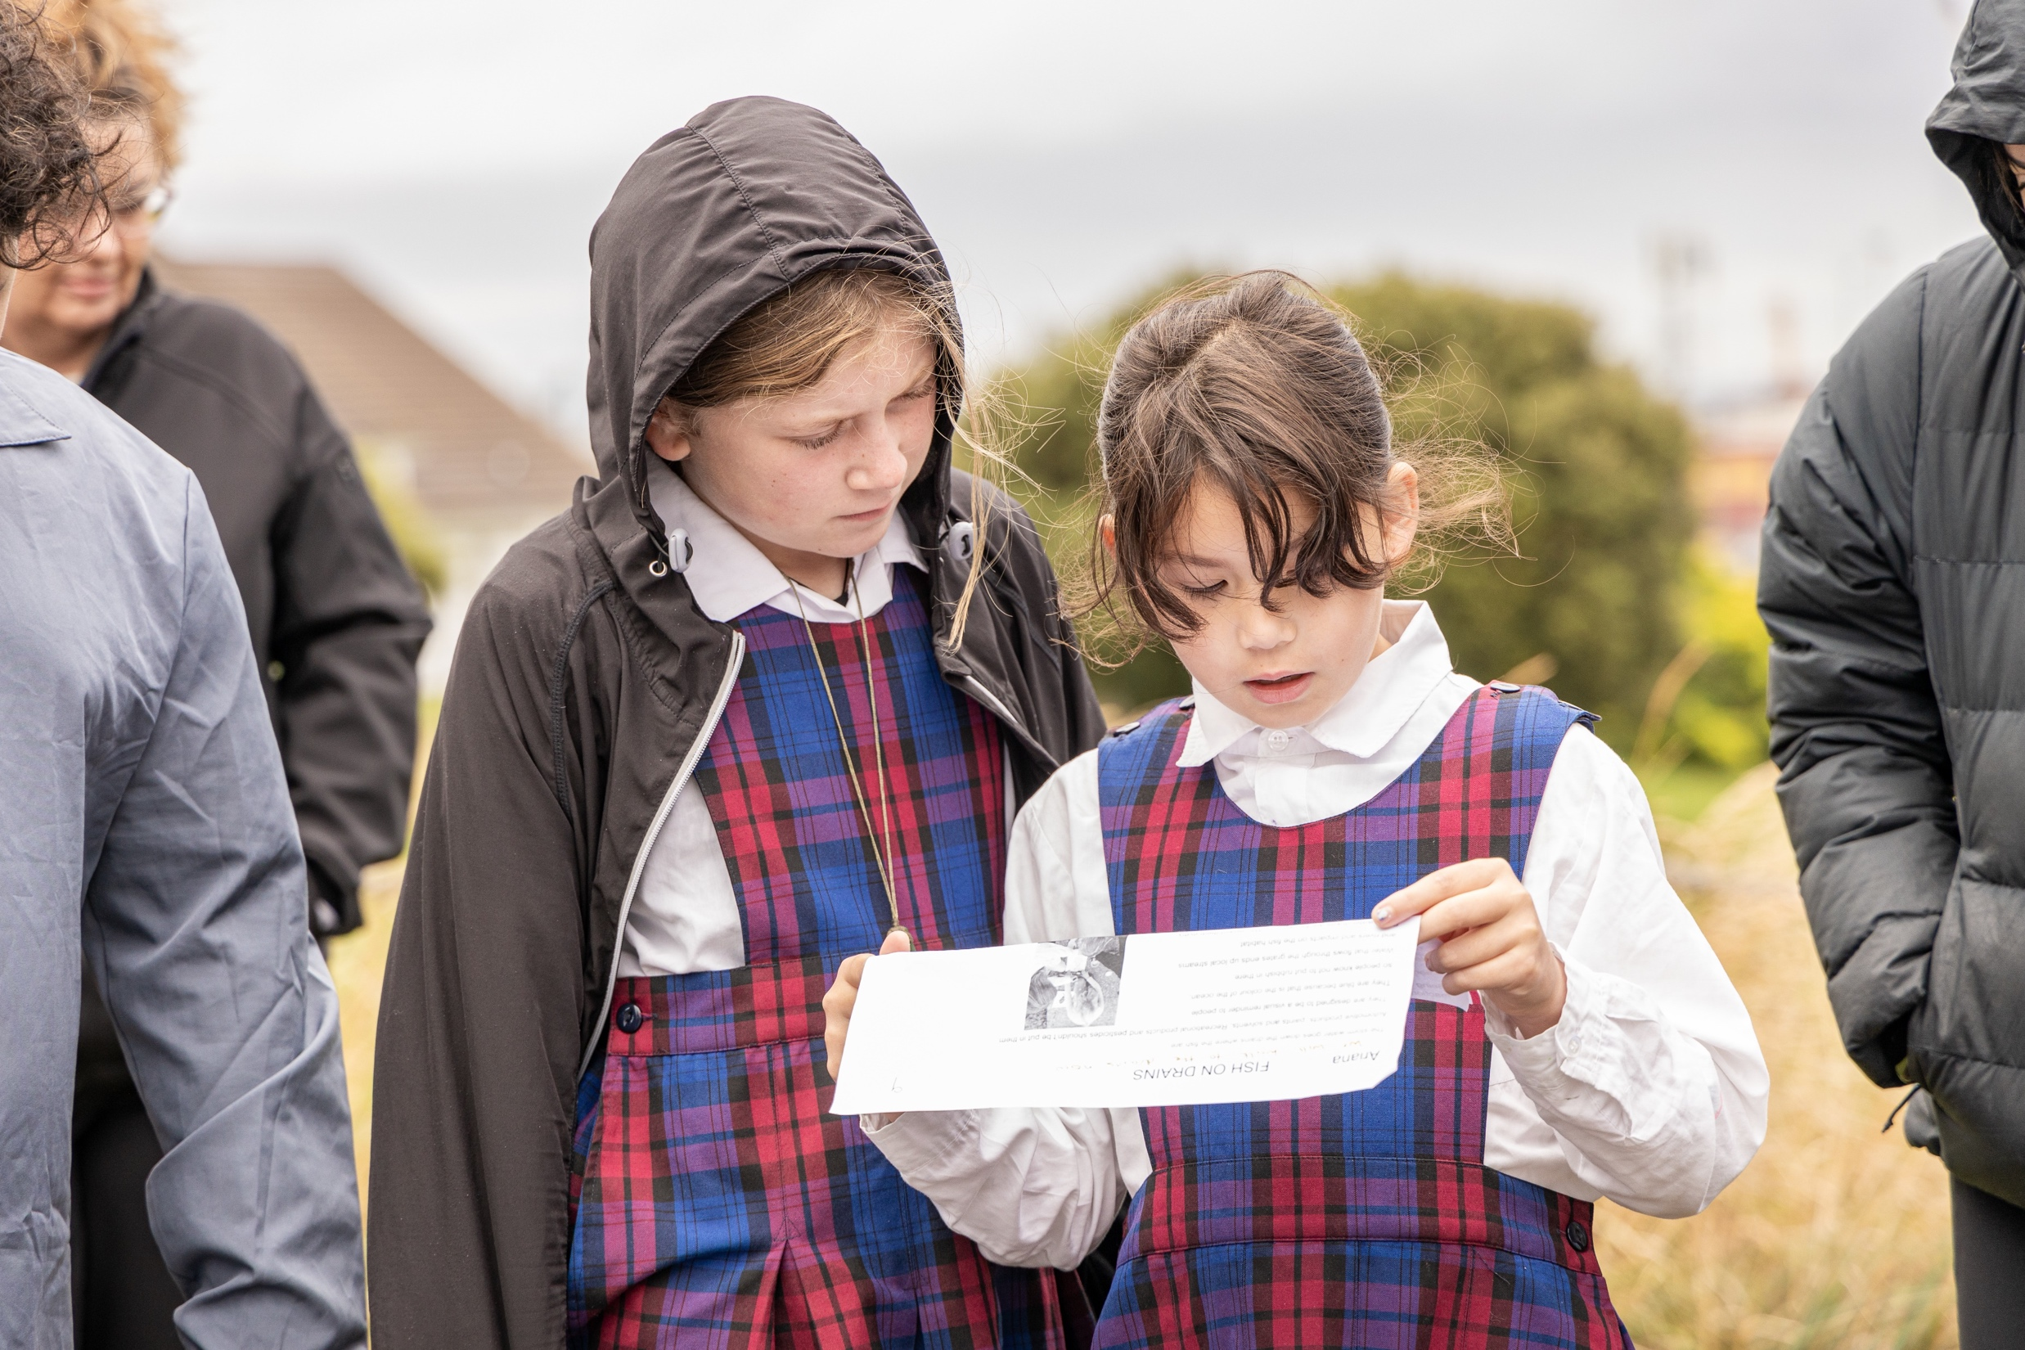
Notes:
Fish on Drains and Bluff community street clean up day involvement.

Slide 16
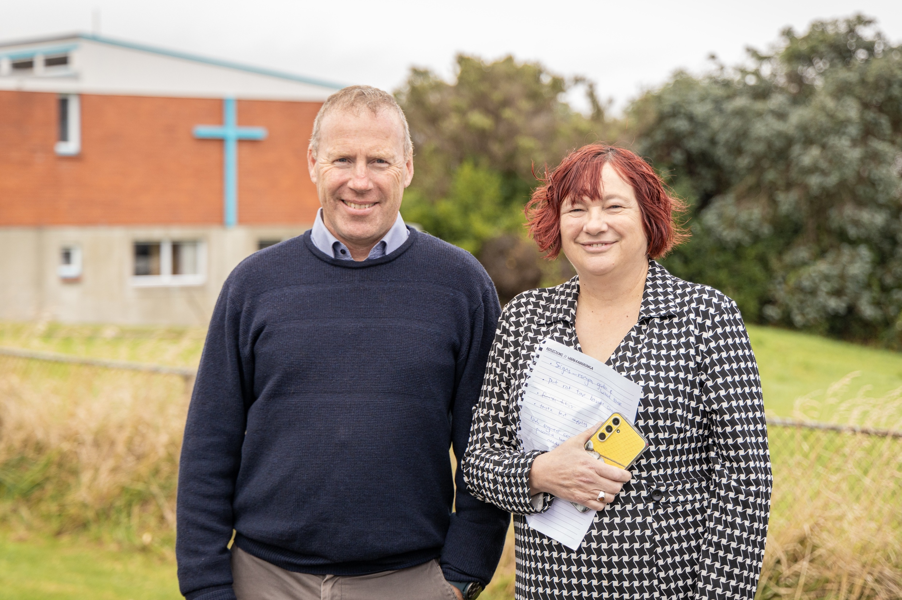
Notes:
Rosi and Father Gerard.

Slide 17
Notes:
Worm farm learnings.

Slide 18
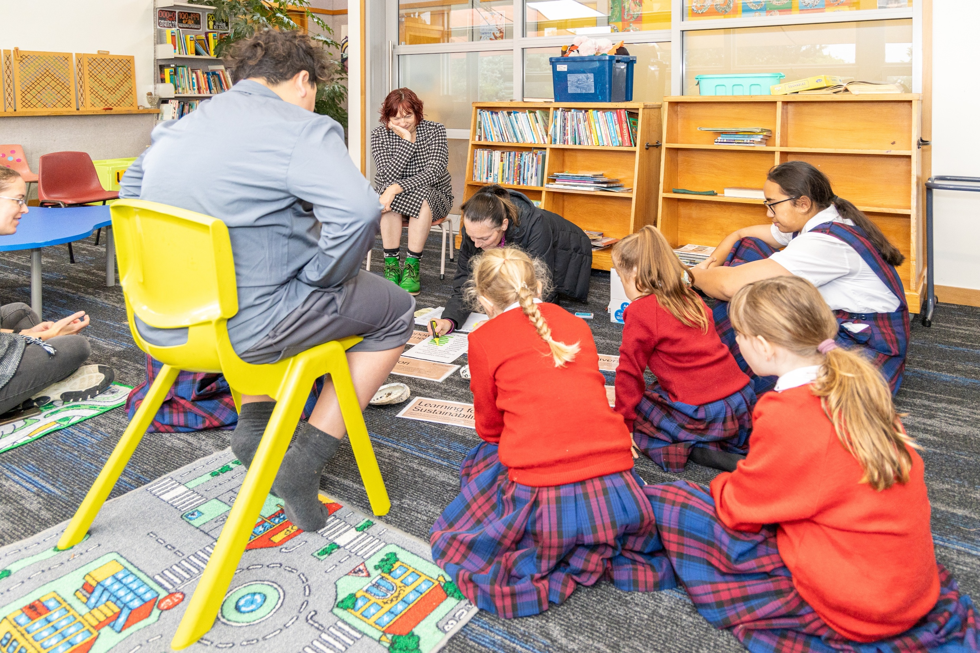
Notes:
The decision making begins.

Slide 19
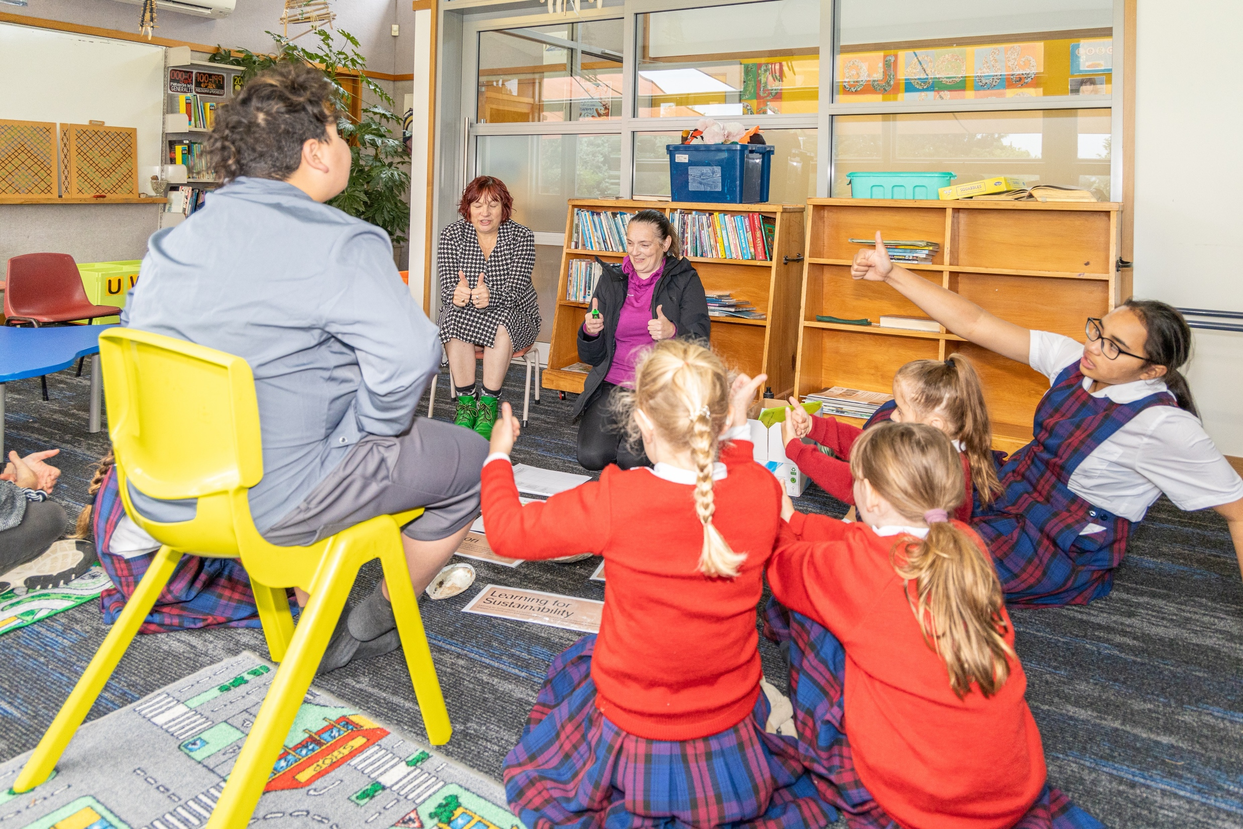
Notes:
Analysing the evidence.

Slide 20
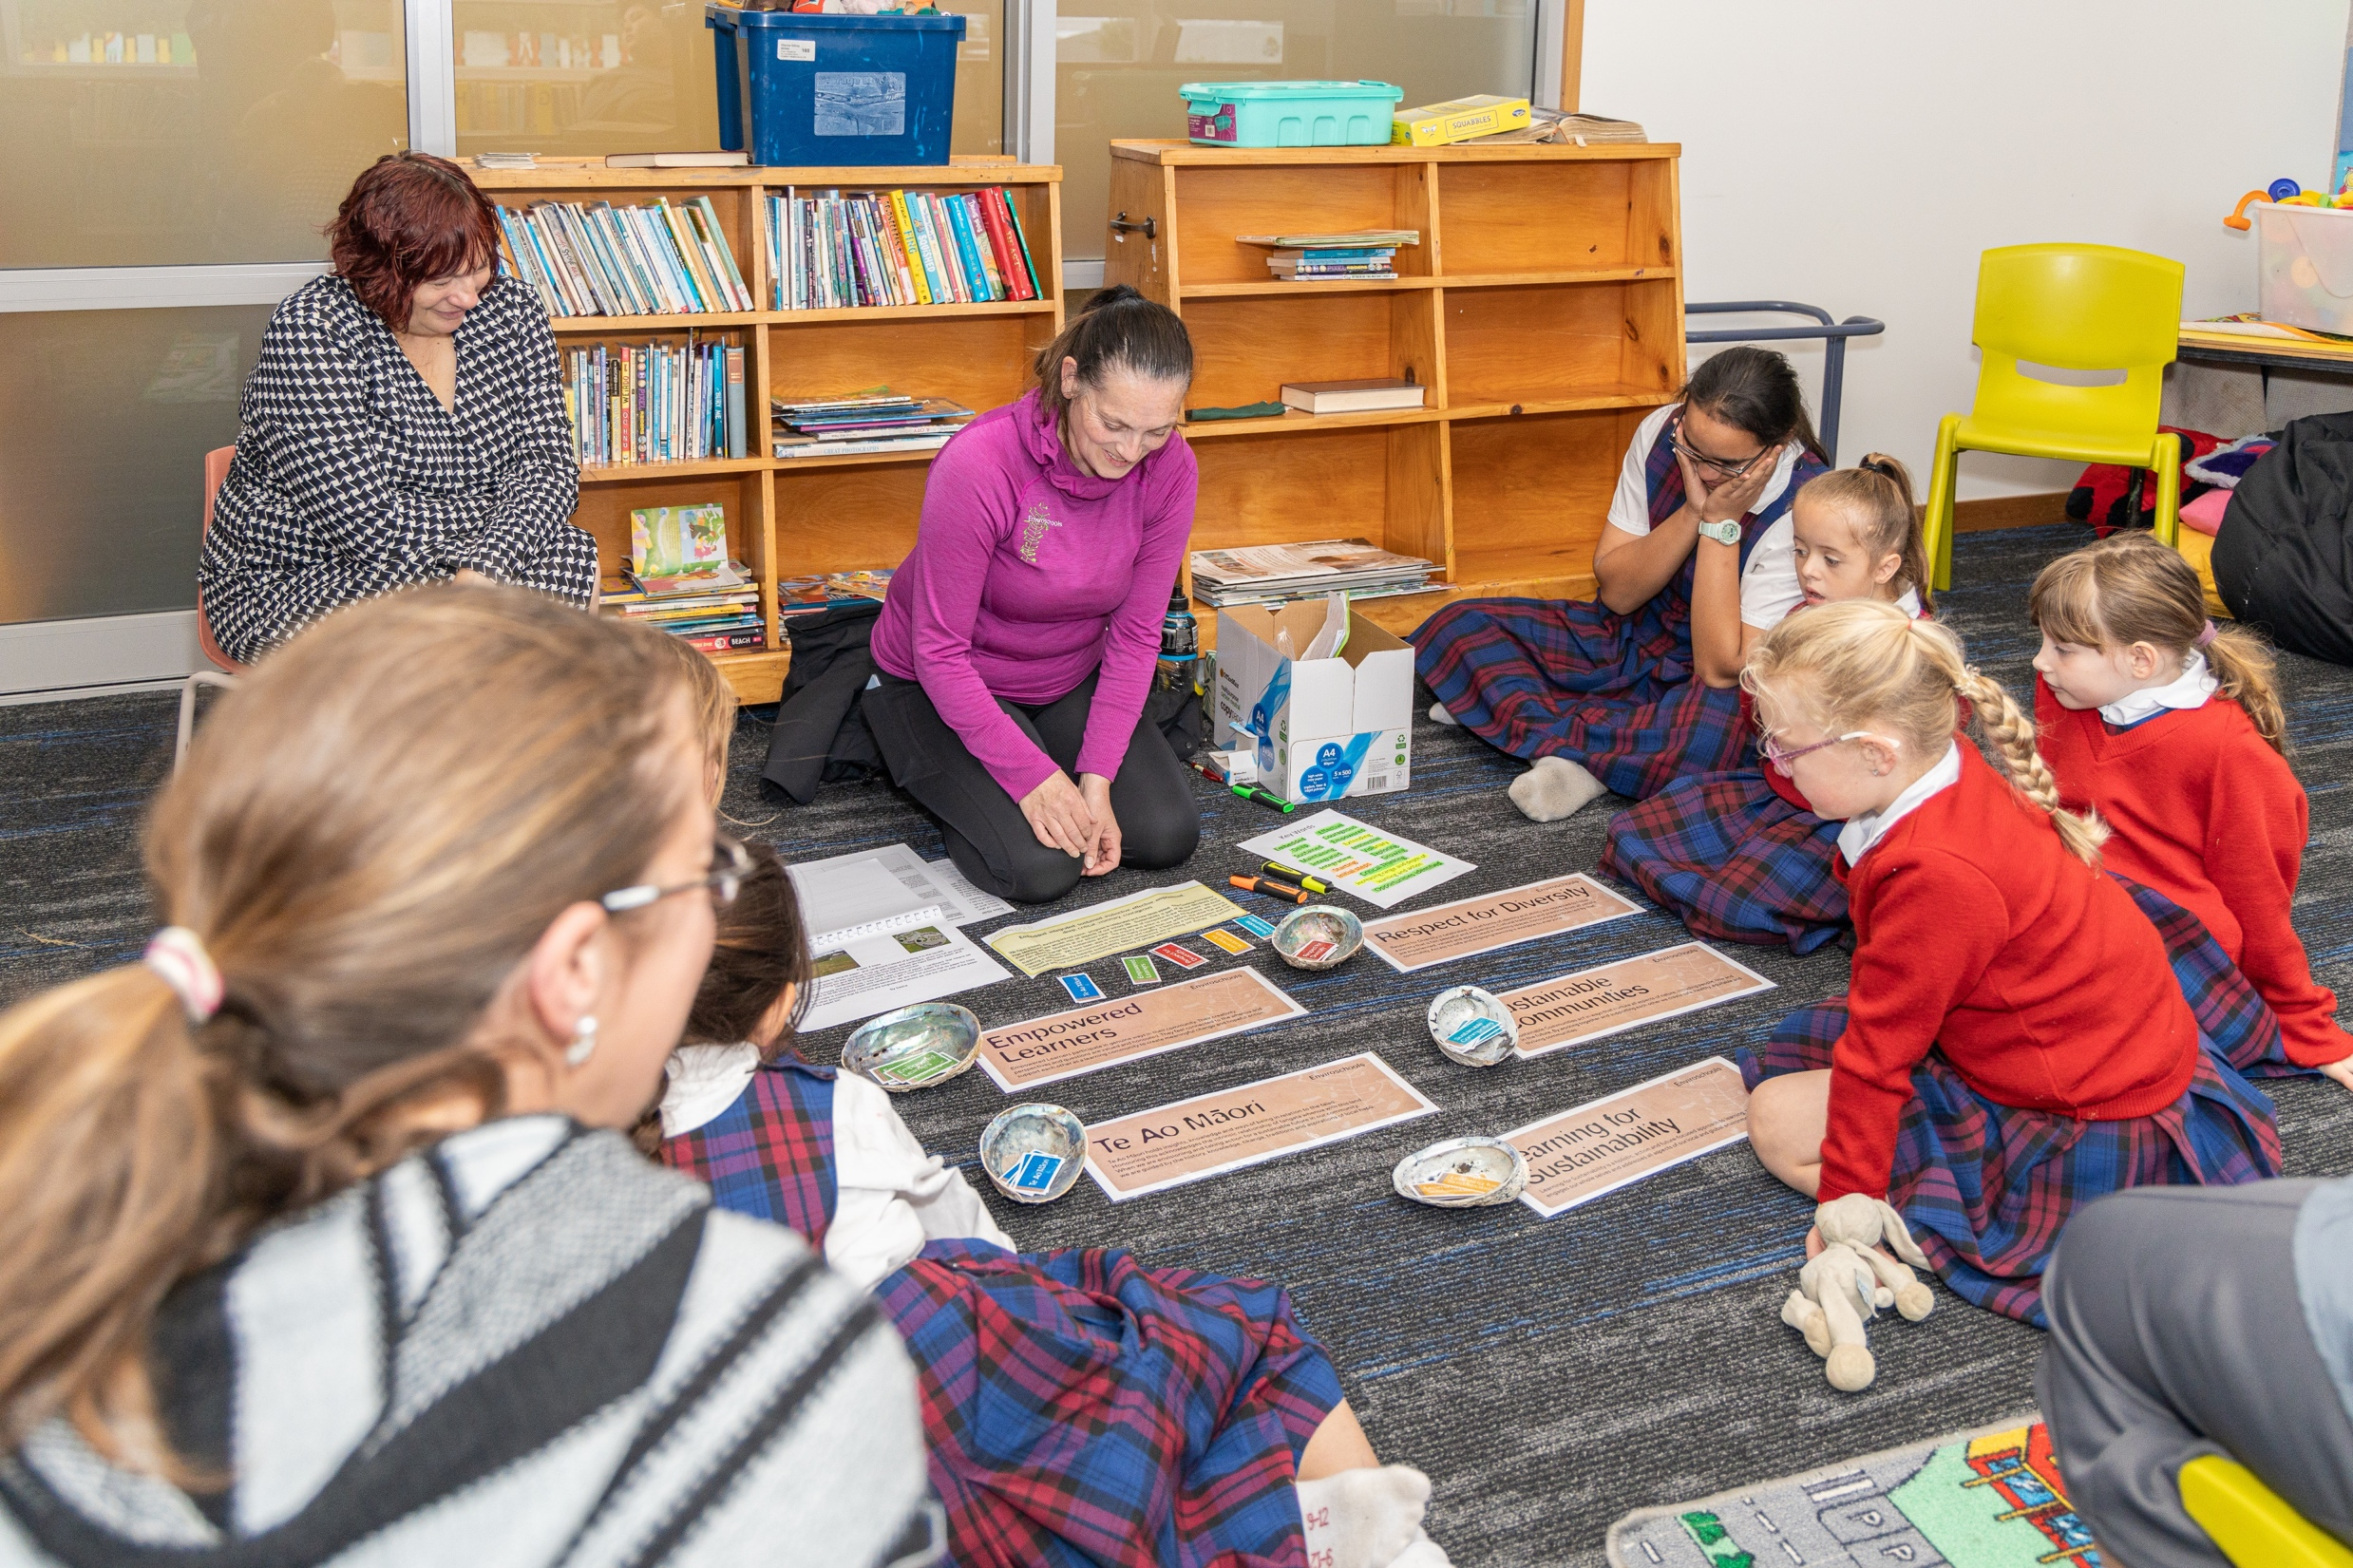
Notes:
All the evidence has been analysed.

Slide 21
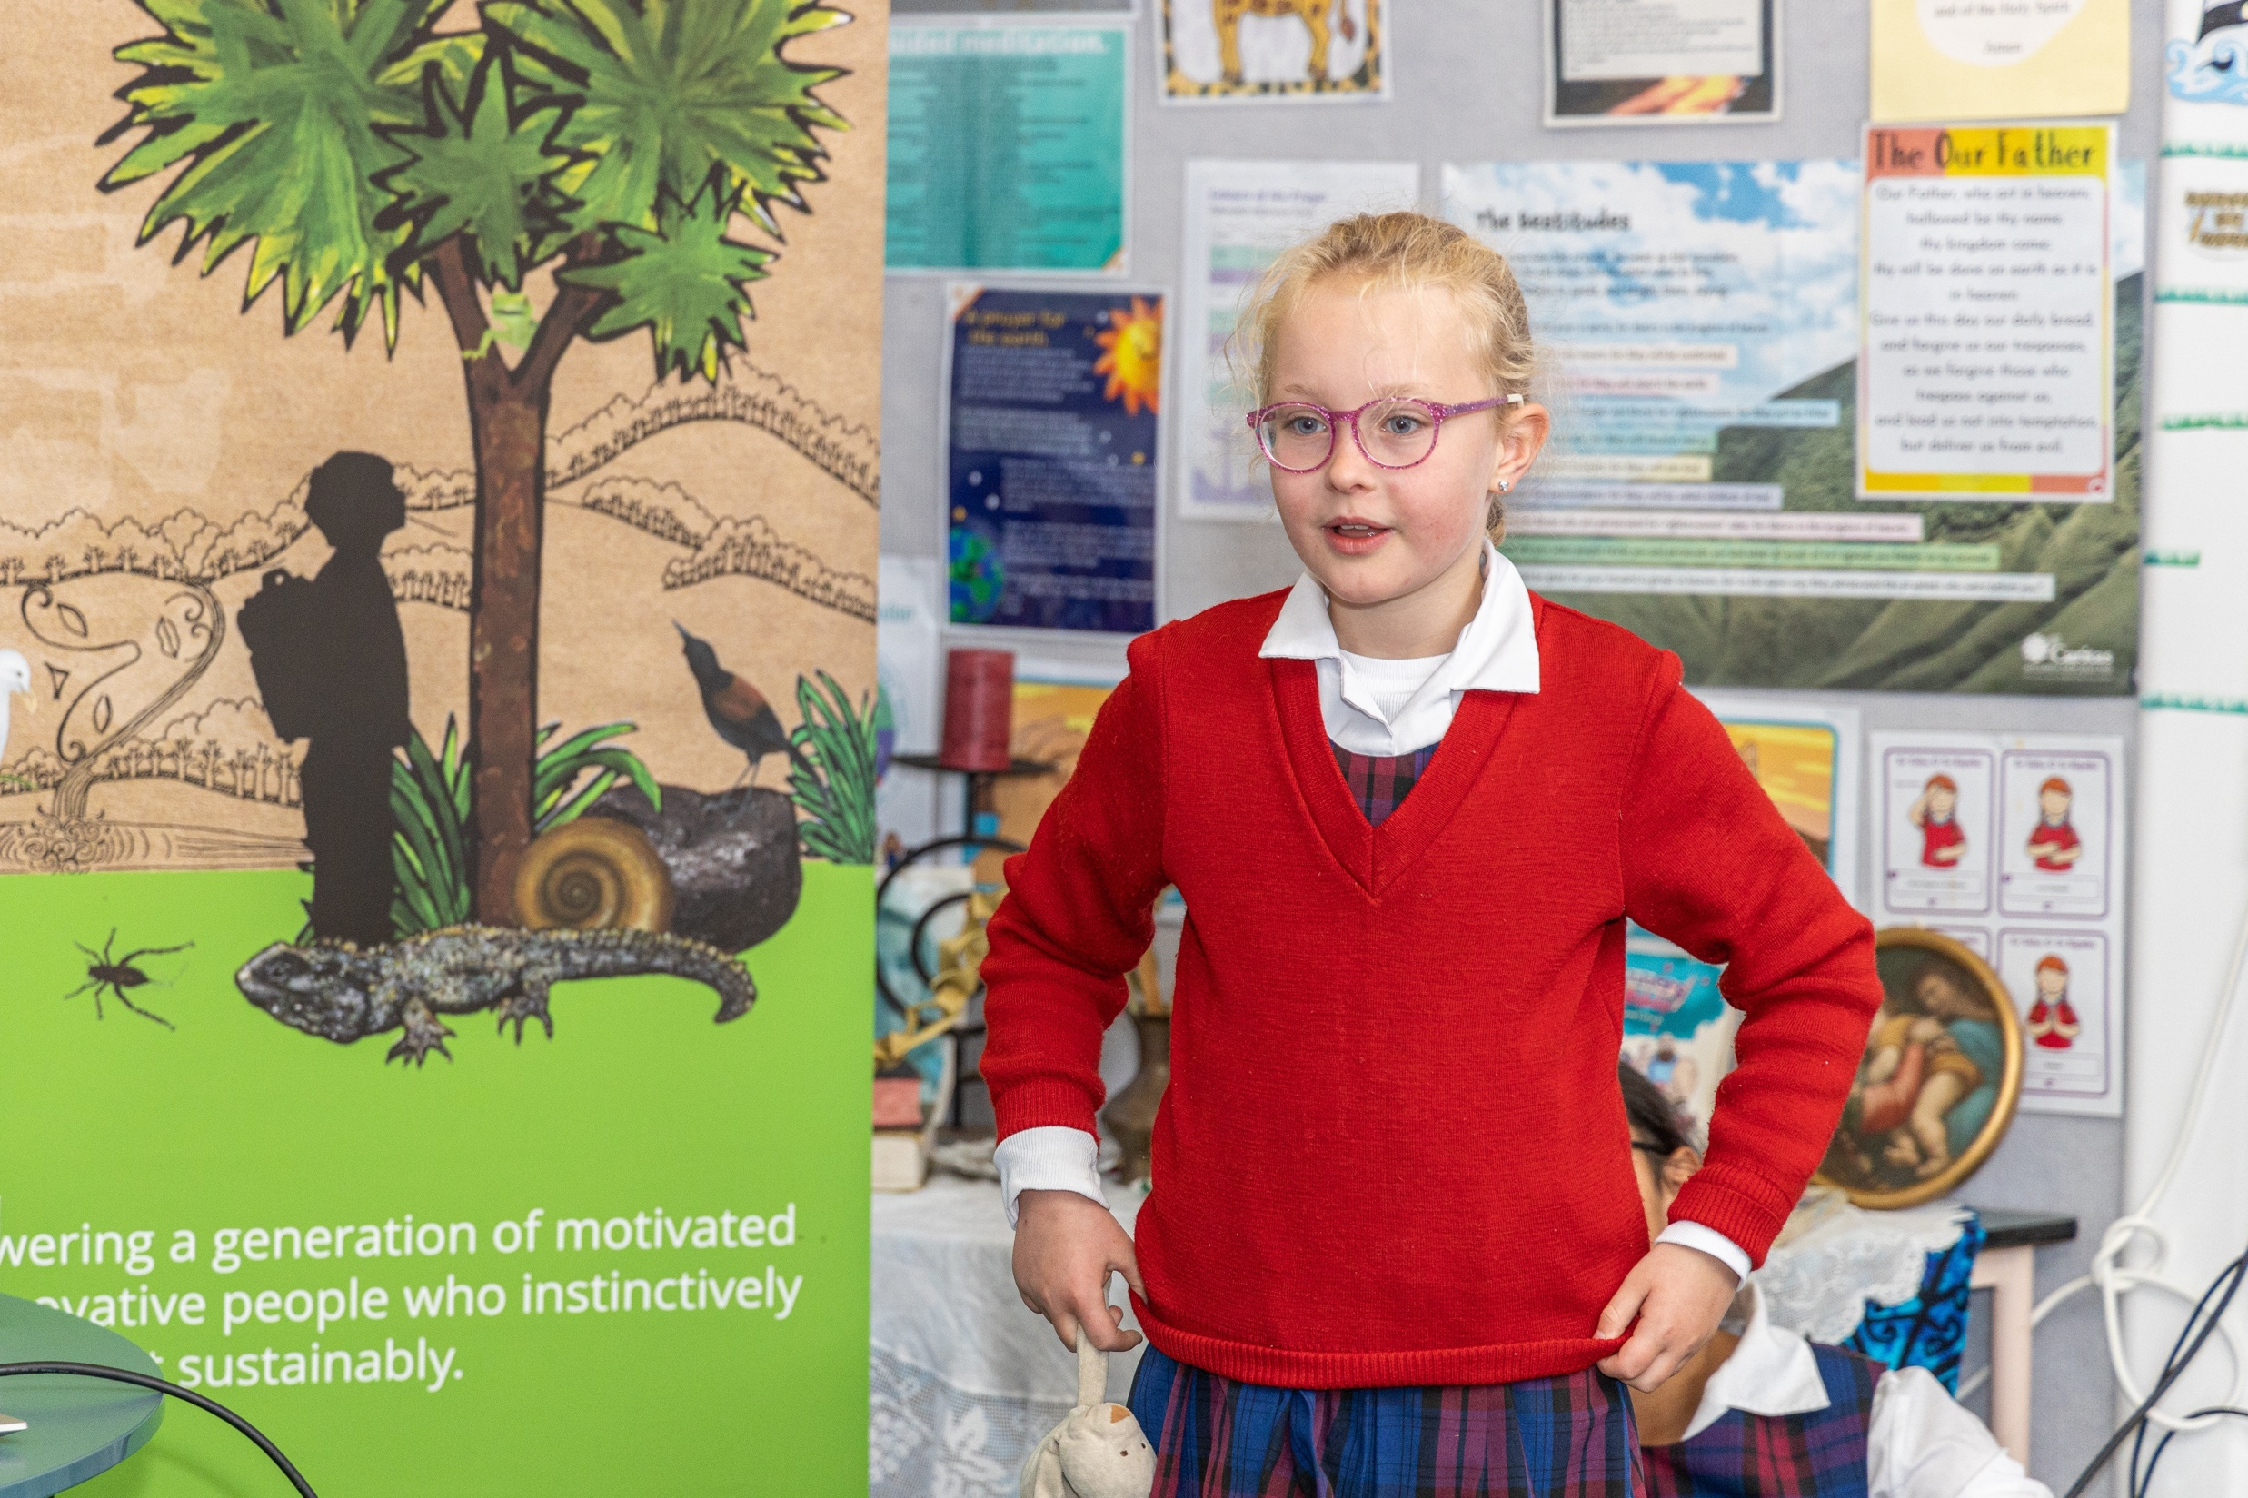
Notes:
Announcement of the decision!

Slide 22
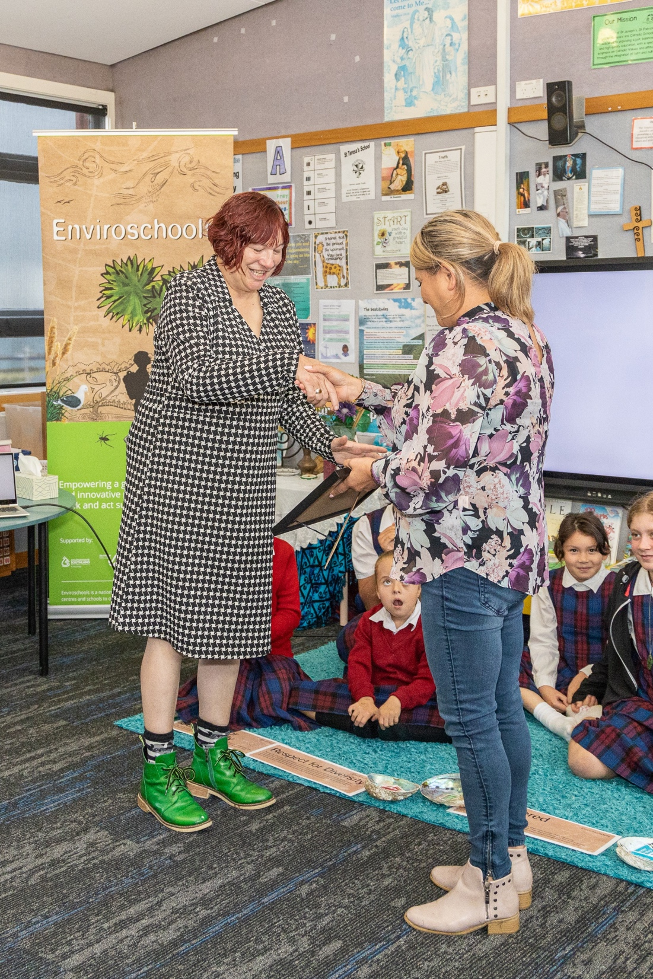
Notes:
Councillor Ria Bond presenting Rosi with the Green-Gold certificate.

Slide 23
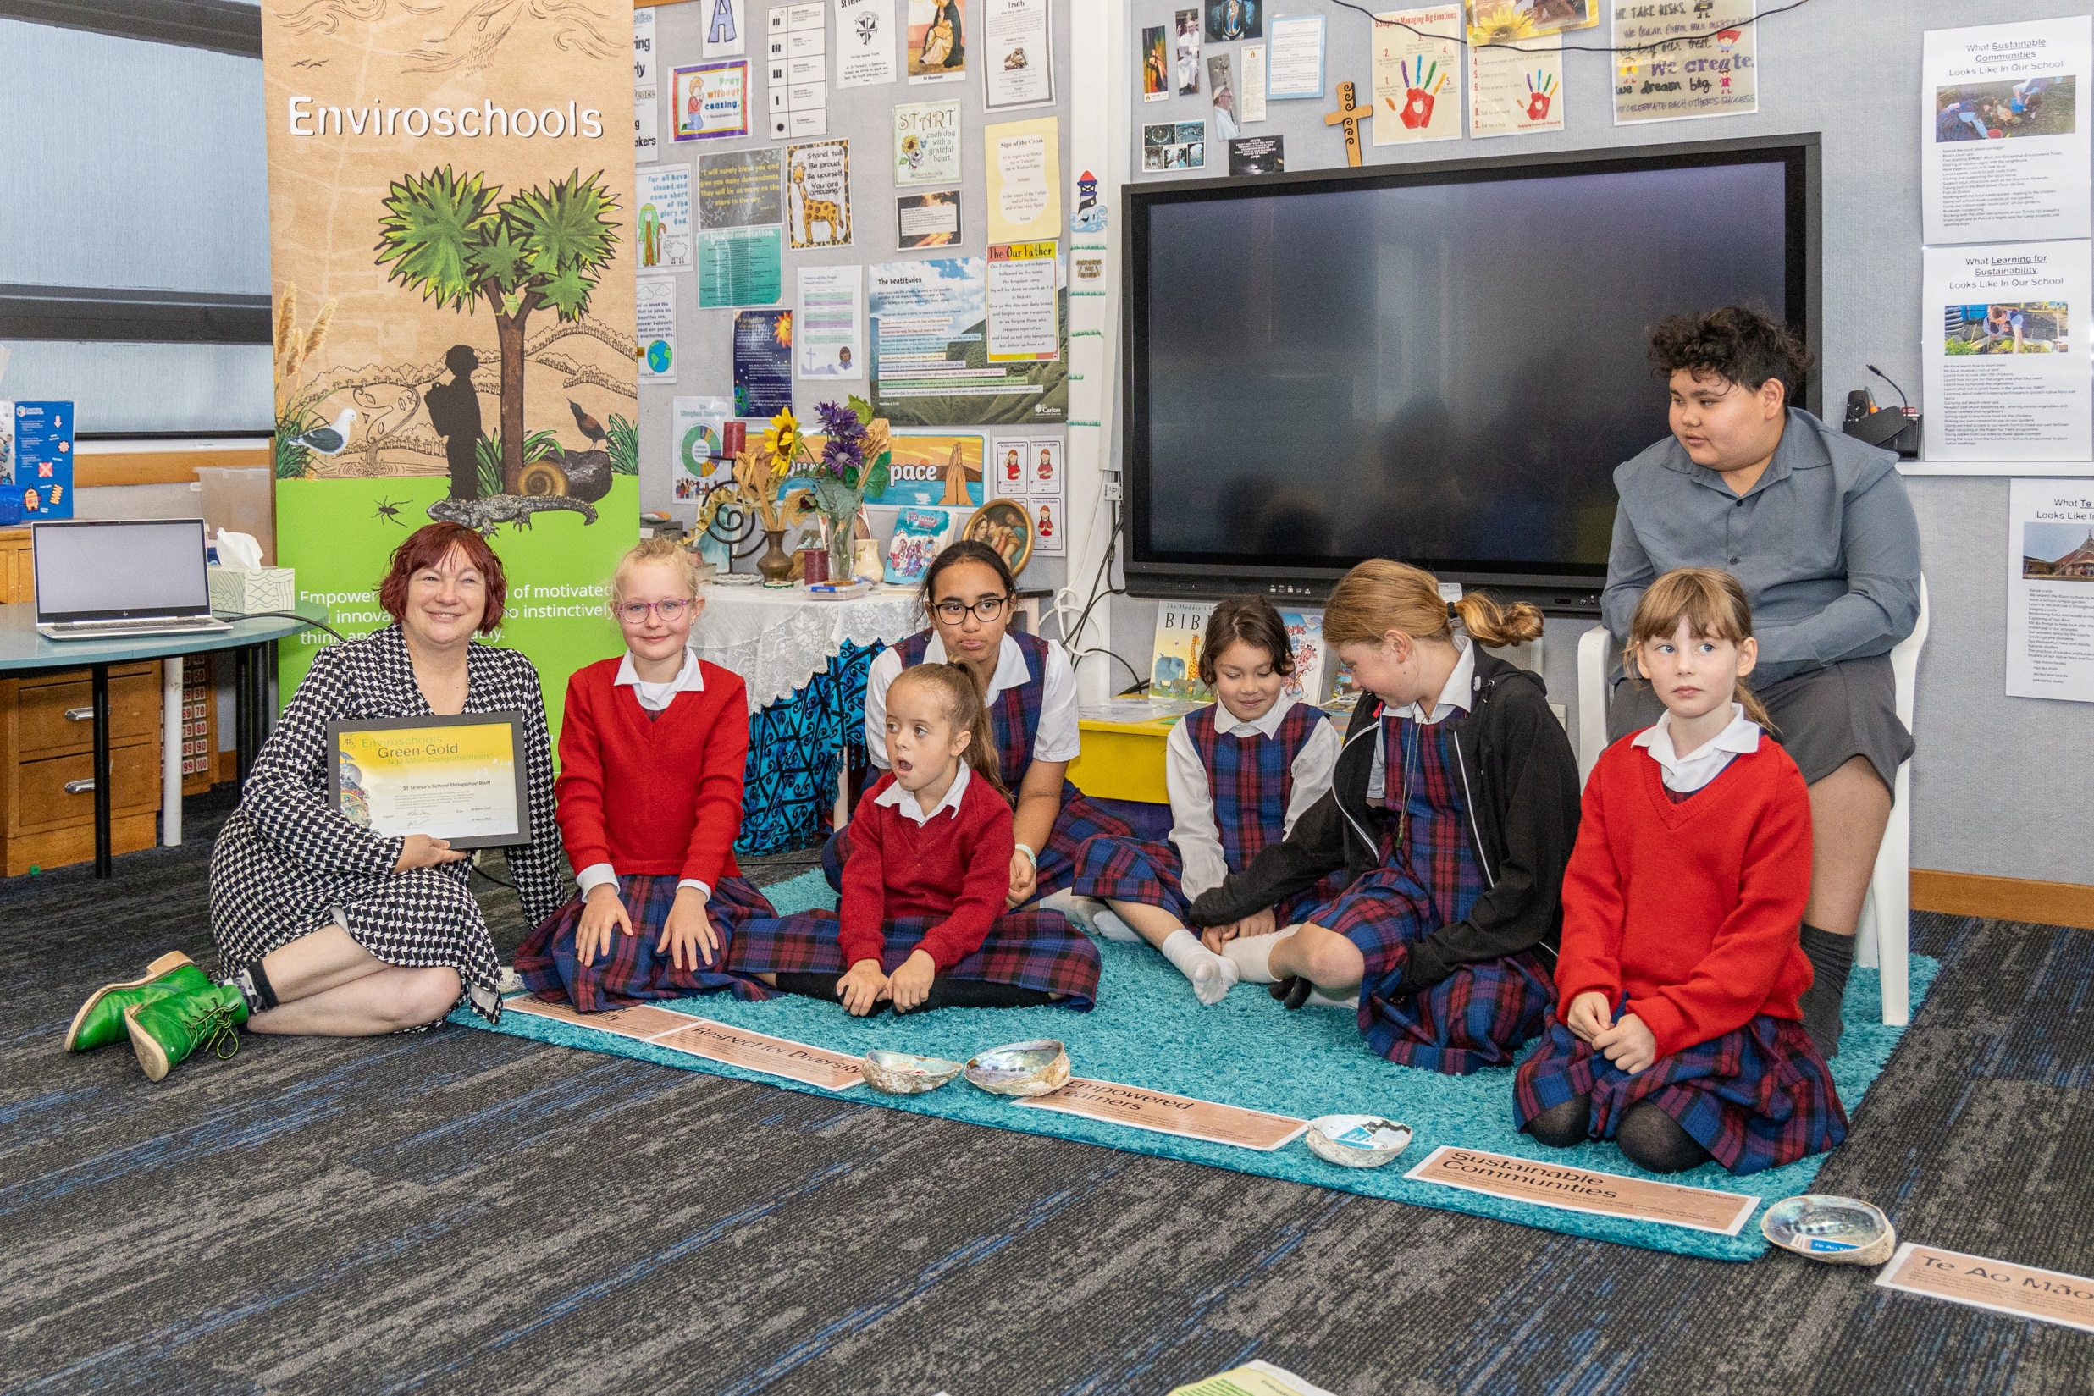
Notes:
Rosi and the tamariki.

Slide 24
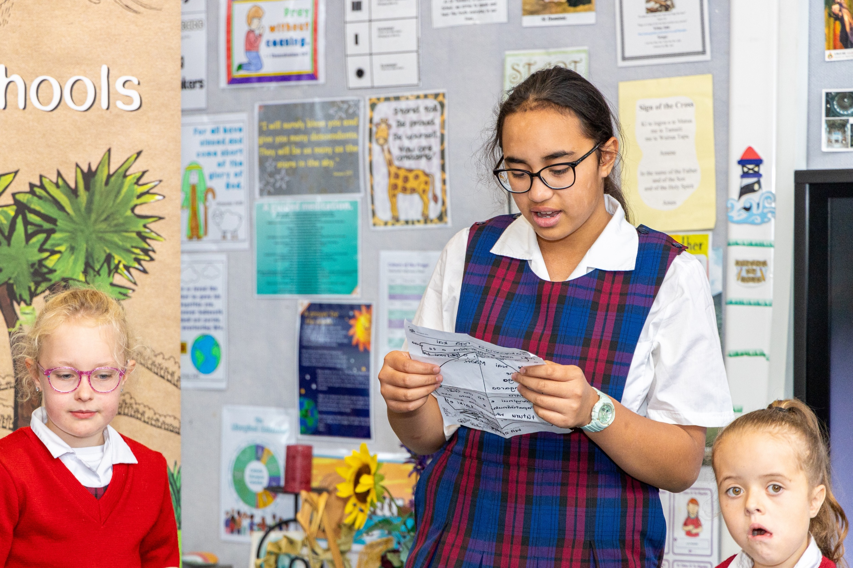
Notes:
Karakia mō te kai before the shared lunch with guests.

Slide 25
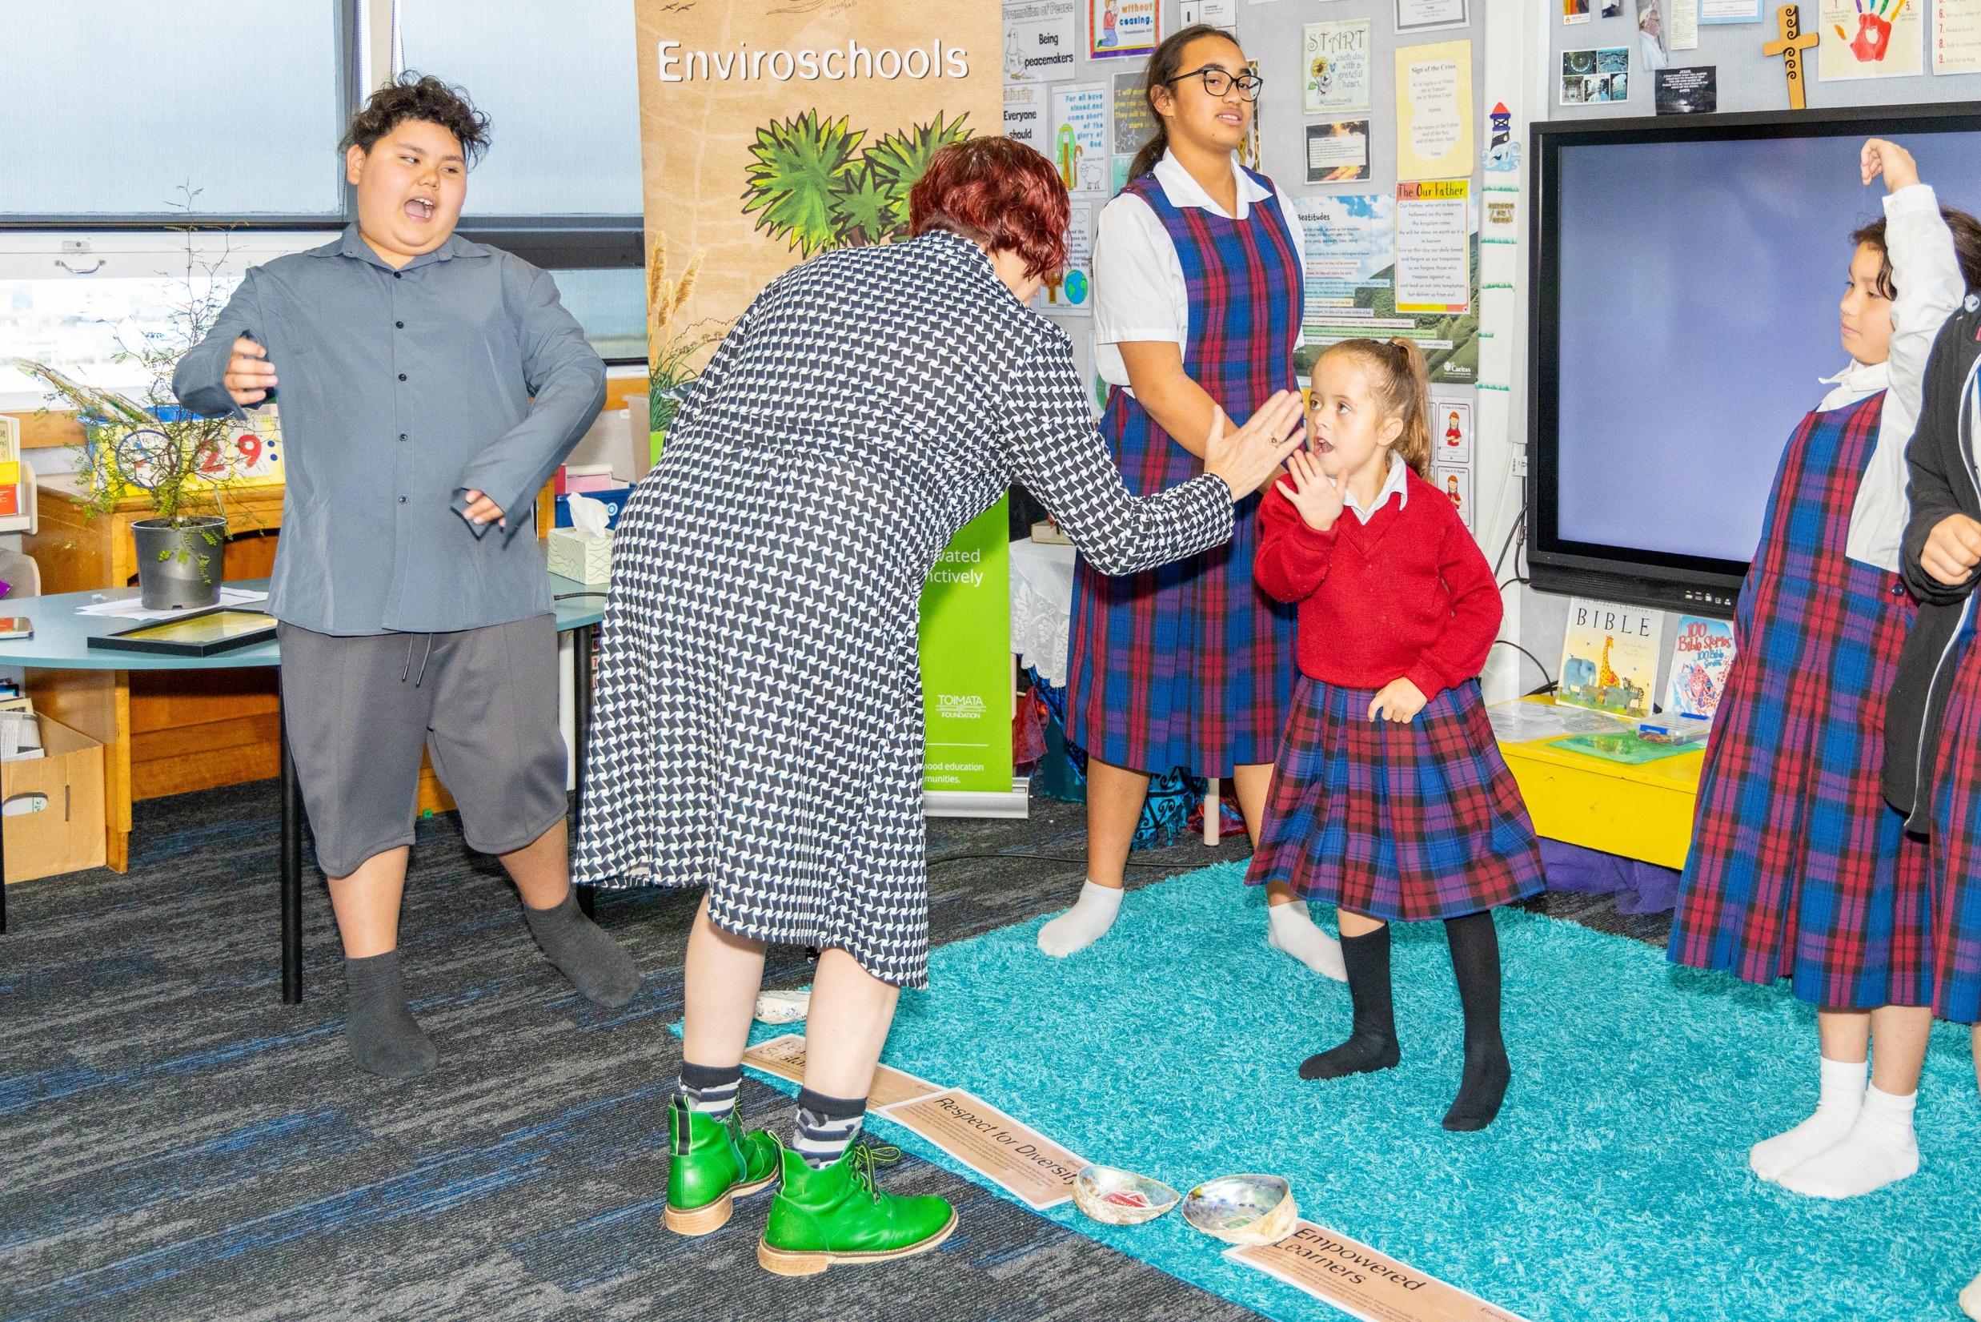
Notes:
High fives all round.

Slide 26
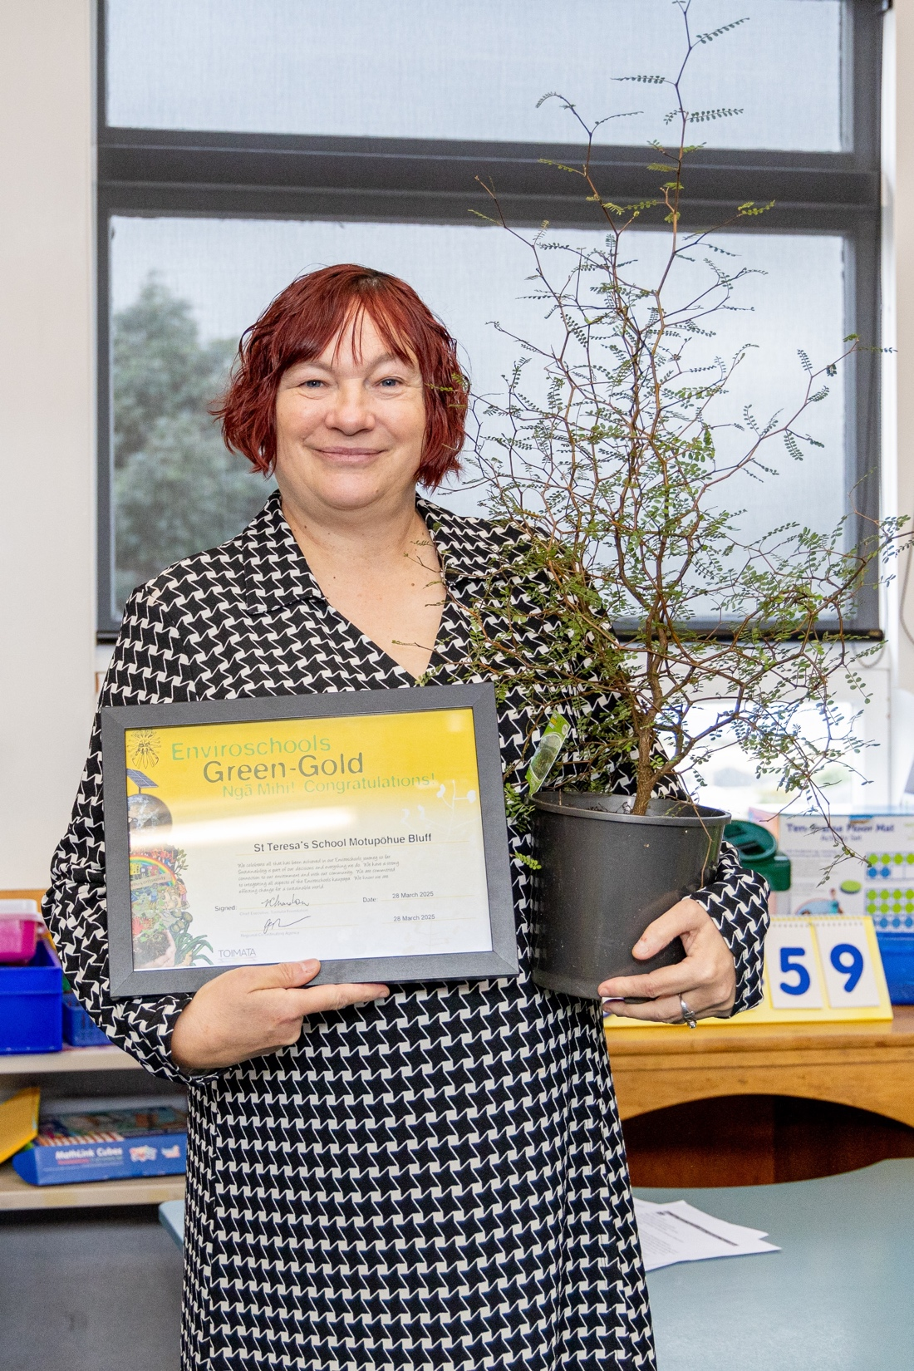
Notes:
Rosi with the certificate and South Island Kōwhai presented to the school from Murihiku Southland Enviroschools.

Slide 27
Notes:
Rosi and former student Zac, who celebrated with us on the day.

Slide 28
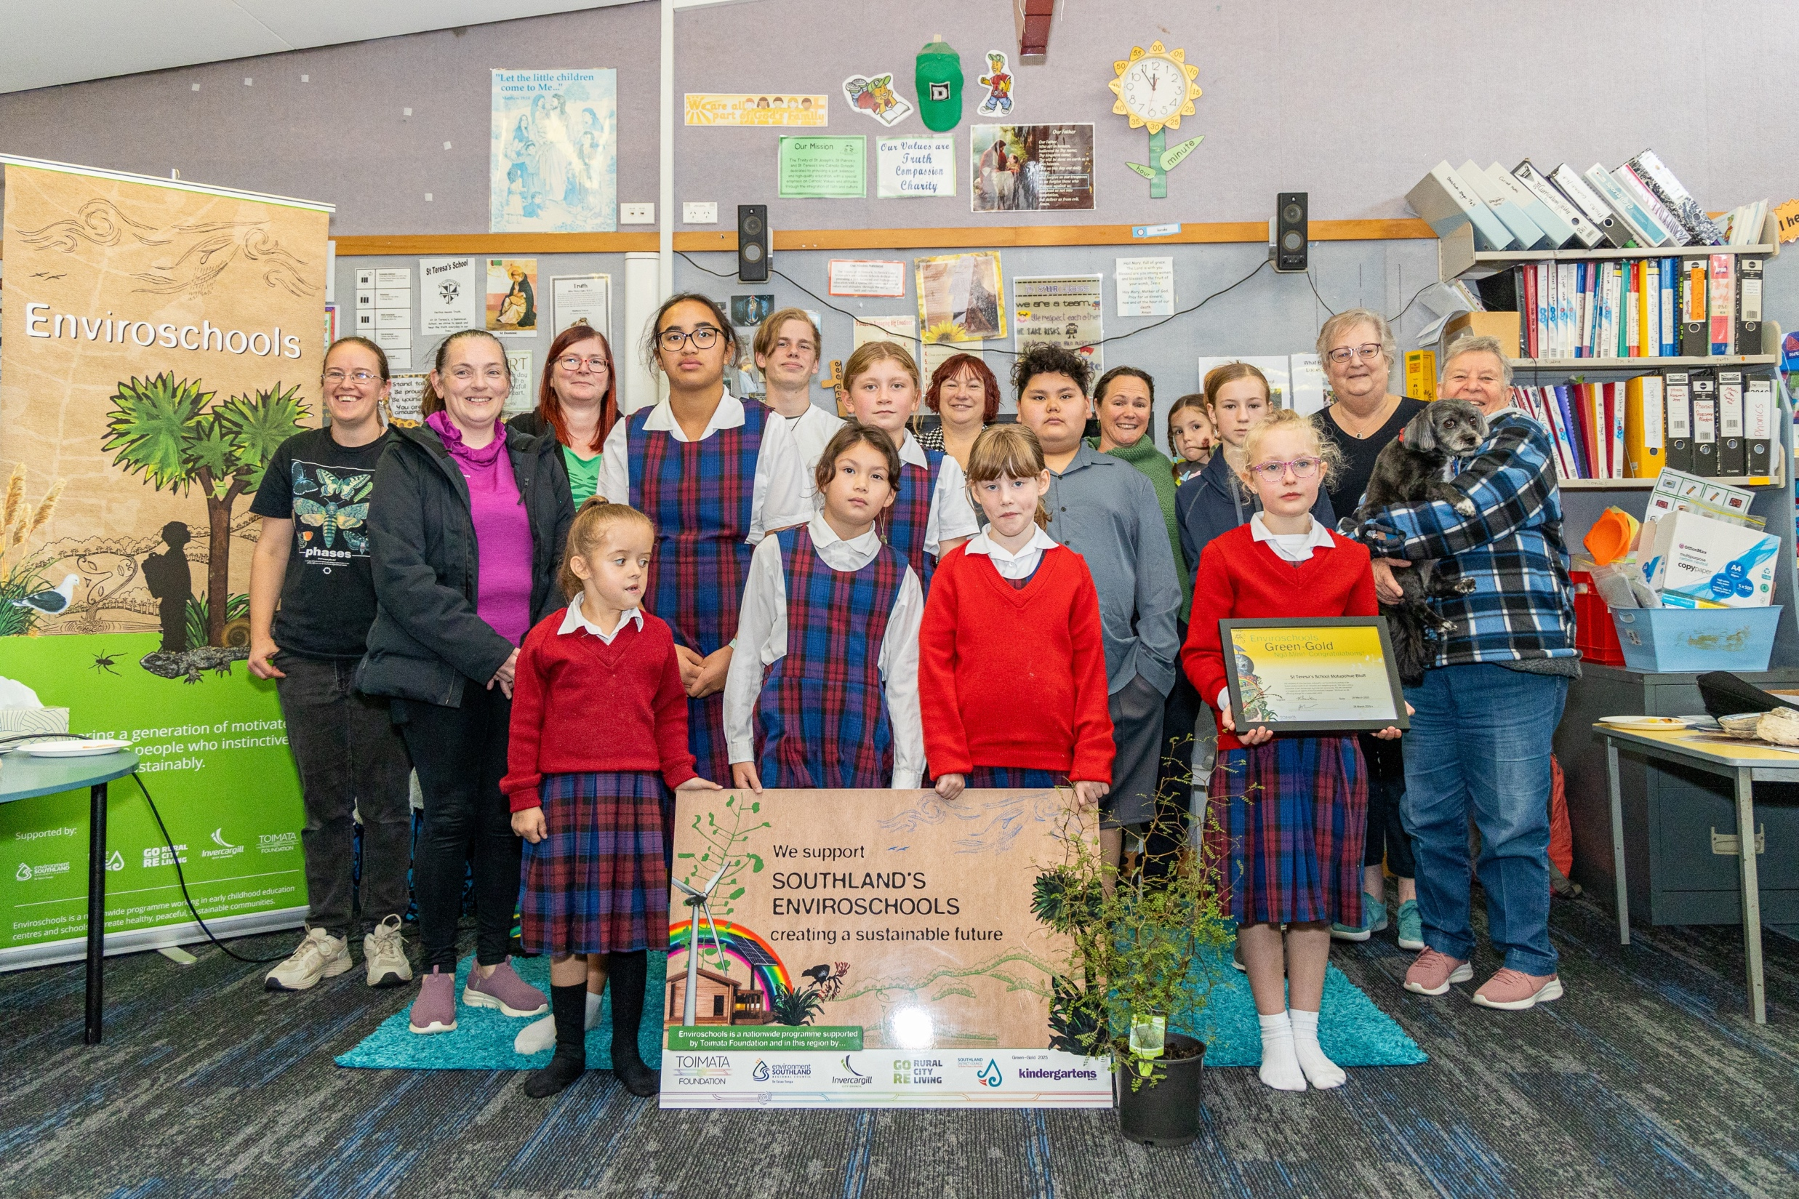
Notes:
Past and present staff and students who have all been a part of this journey.

Slide 29
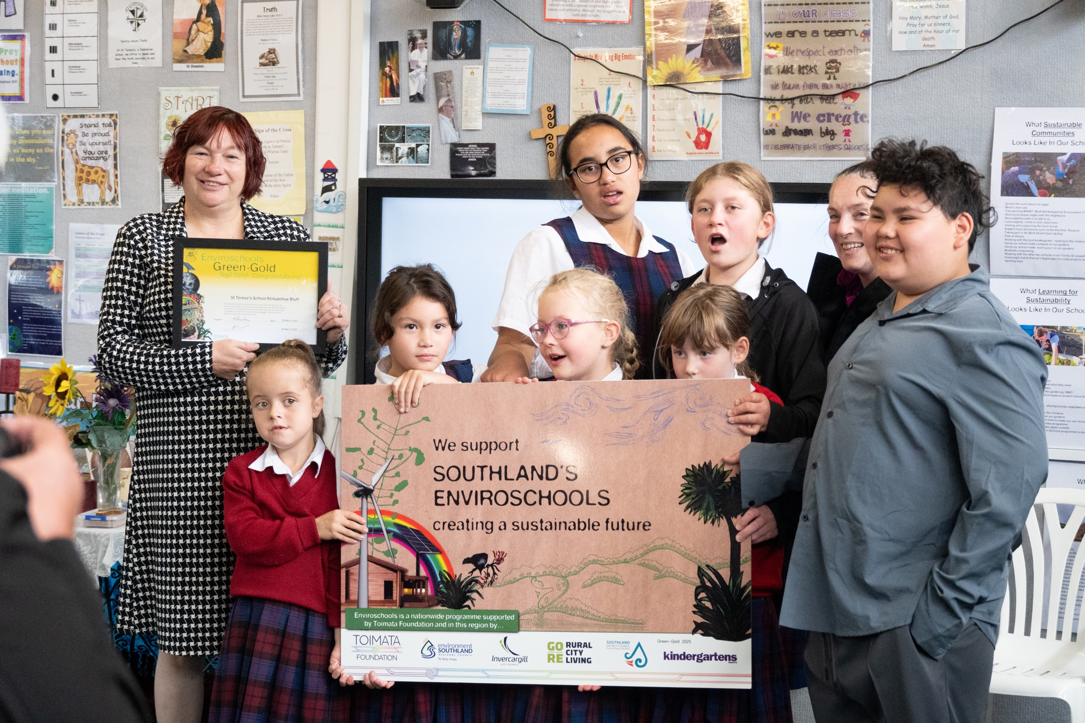
Notes:
Yay! We did it 😊

